Slide 1

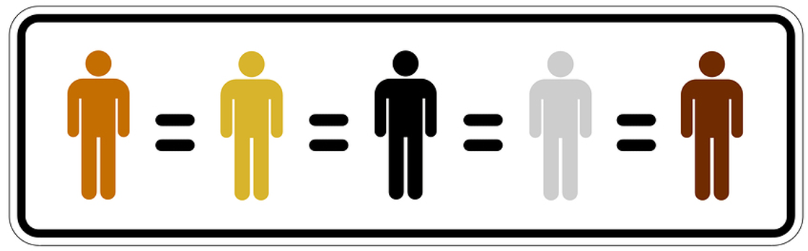
Linking Brain Research
with Access, Equity, and Inclusion
CABSE 2018
Kenneth Wesson
Educational Consultant: Neuroscience
San Jose, CA
kenawesson@aol.com

Slide 2

Special thanks to
Michael Yorio, President
SSI Guardian

Slide 3
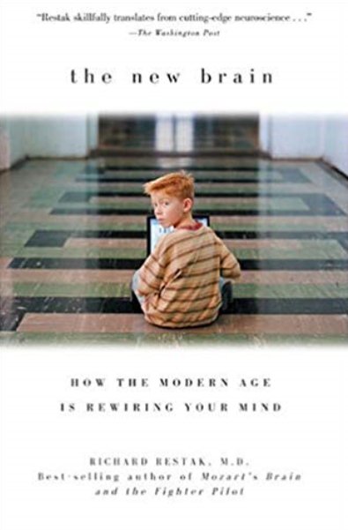

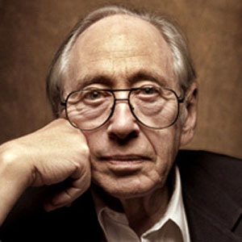
Abandoning Our Cognitive Frames
The illiterates of the future are not those who cannot read or write, but those who cannot learn, un-learn, and re-learn.
--Alvin Toffler

Slide 4
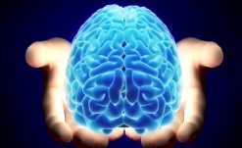

Linking Brain Research
with Access, Equity, and Inclusion
How does the biological and emotional human brain work? How can we give every student access to LT learning that leads to academic success?
What role do (a) teachers’ attitudes, (b) our students’ emotions, and (c) active experience play in learning, memory and student achievement?
How do I get my students’ attention and keep them engaged in order to learn more deeply?
“How do I make certain that every classroom practitioner in my building becomes an unforgettable teacher?”
Interactions, quick writes and quick talks

Slide 5
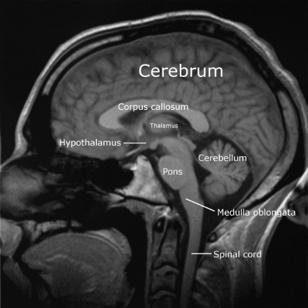

When it Comes to Learning
Only the Gray Matter Matters
Our students come in a variety of colors, but all brains are basically gray. It is only the gray matter that truly matters in learning and memory.
Boosting achievement and maximizing student potential hinges on educators developing a robust knowledge reservoir for teaching with only the color of the brain in mind.

Slide 6
A Teacher’s Mindset
“Learning is a fundamental human need; education is a basic human right that we must extend to every child."
-- Daniel Schwarz, Stanford University
“What formal education for one child for one year depends on what his/her teacher believes, knows, and does –
and doesn't believe, doesn't know, and doesn’t do".

Slide 7
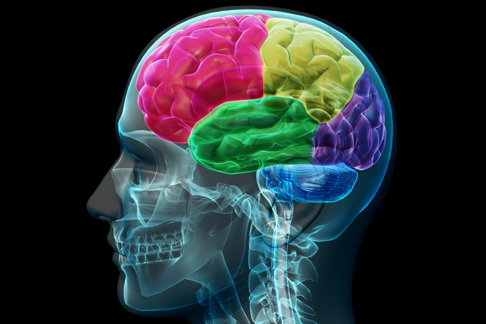
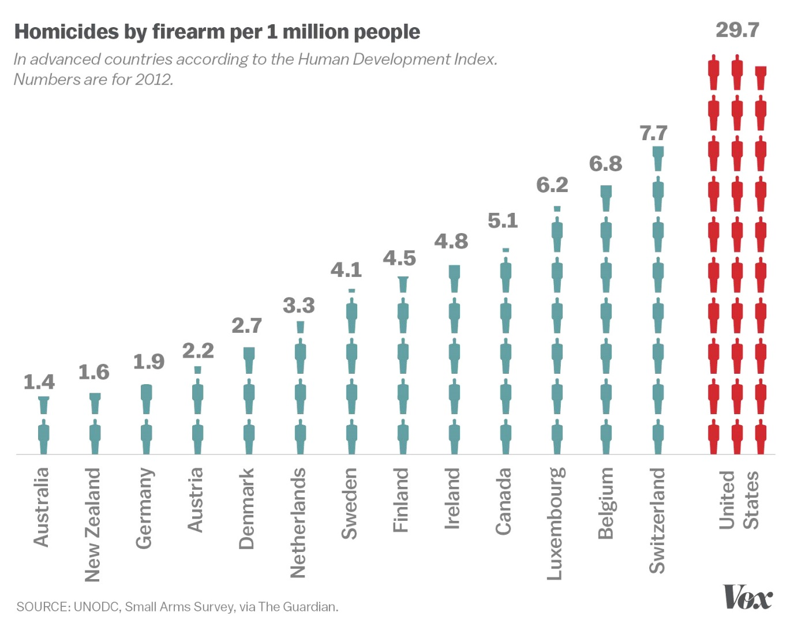
Cognitive Science
Children/students (young brains)…
  grow at different rates
  learn at different rates
  learn in different ways
  reach competence in skills more effectively through different strategies/means
  learn some content information more slowly, and other types of information/skills quicker and more deeply (with different strengths and capabilities)
  Cannot teach all students at the same pace in the same way

Slide 8
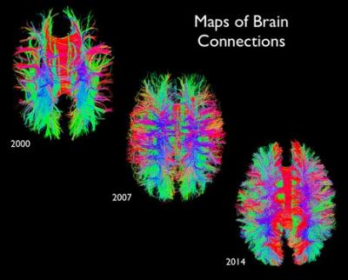
Knowing Your Students
Knowing who you teach (a child with 100B neurons capable of making an infinite number of learning connections for a lifetime) is just as important as what you teach (disciplinary content).
“I teach algebra.” No, you teach students whose brains prefer to learn by actively making elaborate connections.

Slide 9
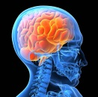
African-American History You Do Not Learn in School
Institutionalized discrimination/bias Taken to Extremes
There is an unseen implicit curriculum (like “smog in the air” – no formal coursework needed) that our “different” students “feel” from the treatment that they (and people like them) receive everyday. It is often more powerful than the explicit curriculum.

Slide 10

Whose culture is admirable?
Who is intelligent?
Who is “normal”?
Who is “a problem”?
Who is “deficient”?
What constitutes beauty?
Whose customs are strange?
Whose language is “standard”?
Who decides? Who will benefit? Who loses? What are the consequences for each?

Slide 11
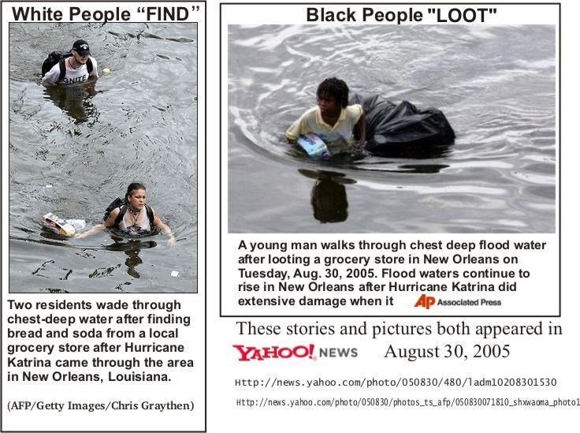
Shaping (slanting) Perceptions

Slide 12
Racial Disparities in Use of
Suspension for 1st Time Offenders
Percent of first time offenders cited for committing the offense who received an out of school suspension as punishment
Source: Losen, 2012
Notes:
This means that those who were not suspended out of school the first time received another less severe punishment, such as in-school suspension, or no punishment at all.

Slide 13

The Brain and Movement in School
(Disruptive?)
A 5th grade class in Charlotte, NC - increased attention spans and facilitated good posture. The classroom - a sea of motion - children bob and weave, sway and bounce their way through lessons perched atop fitness balls.
A Mayo Clinic study found that these balls burn calories, attacking the growing problem of childhood obesity. Fidgety students or those with ADD/ADHD have an outlet for their excess energy. Concentration increases and physical conditioning is improved because of the work involved in staying on top of the ball.
Studies show more time spent on task and less time squirming while students sat on the balls, “The human body was not designed to sit still.”

Slide 14
Mindsets (“Caught” not Taught) in School
The relationship between you and your students
What are the strongest messages that I consistently communicate to my students about themselves, about school, and about learning (+ and -) on a daily basis?
What emotional impact do these messages have on my students?
Are there long-term learning consequences?

Slide 15

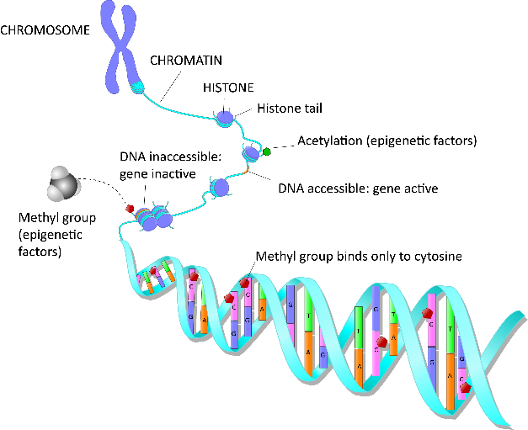

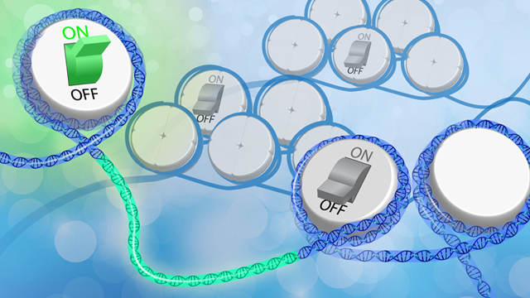
Human genetics reflect our accumulated ancestral history, not our personal destiny, which is determined by our accumulated personal experiences.

Slide 16
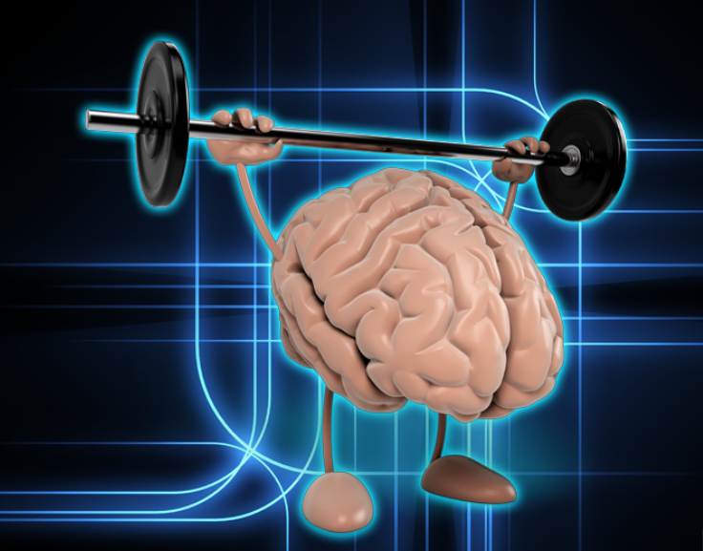
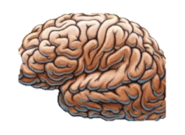
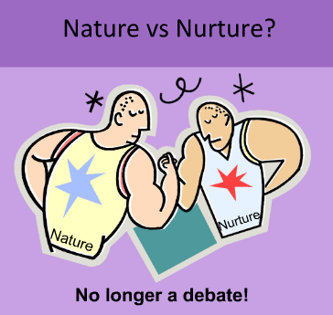
Development results from an on-going and cumulative dance between nurture and nature
Experience
Protective and Personal
(versus Insecure and Impersonal)
Brain Development
Alterations in Brain
Structure and Function
Epigenetic Changes
Bi-directional alterations in the way the genetic program is read
The “mind” is what the body-brain does
Behavior
Adaptive or Healthy Coping Skills
(vs. Maladaptive or Unhealthy Coping)

Slide 17
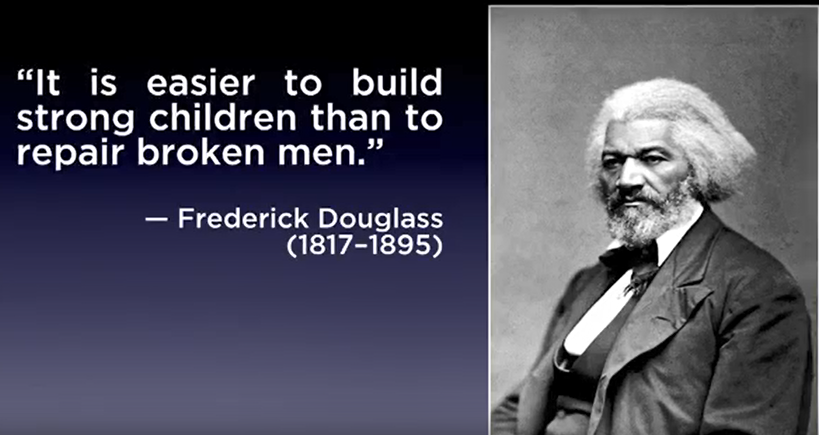
How do we build strong children?

Slide 18
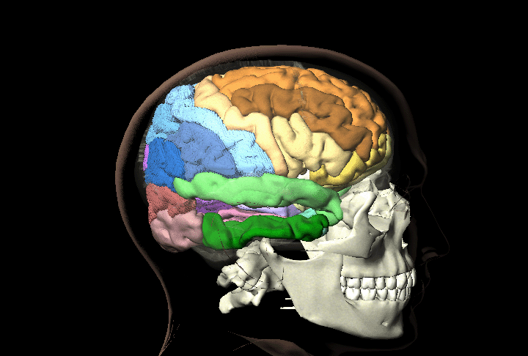

“How does the
human brain learn?”

Slide 19

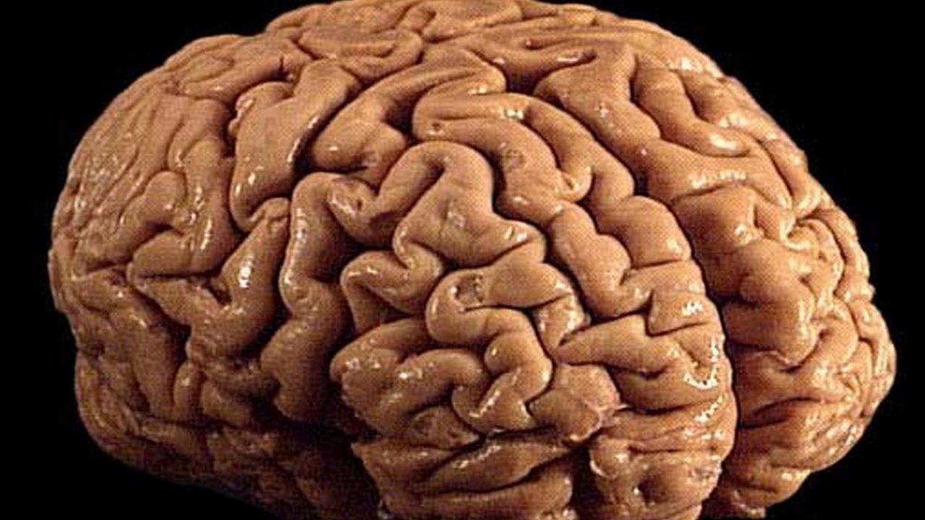
The Function of Every Brain
Experience the World
24/7 we translate our interactions with the world into the chemical language of the brain, and create circuits that represent those experiences

Slide 20
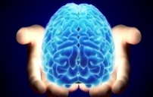
Dr. Carl Wieman, Associate Director for Science,
White House Office of Science and Technology
Most important advances in past 10 – 20 years: Discovering the inter-relationship between classroom studies, brain research, and cognitive psychology
New paradigm: Brains are very changeable (plasticity); brain development and growth facilitate learning and the ability to understand complexity, and its primary role is to make connections.

Slide 21

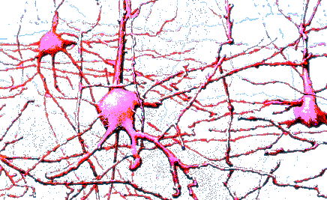

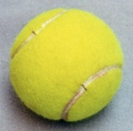



Making Connections
Egg yolk
ball
Baseball
round
yellow
basketball
coconut
Tennis
Brown
School bus
banana
Taxi
Apple
fruits
persimmon
Orange
pear
Train
pineapple
“Re-purpose” the same cells for participation on countless related brain circuits

Slide 22

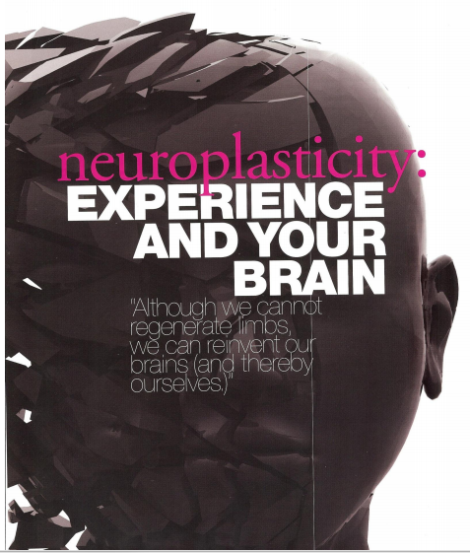
Understanding Builds
Over Time
Neuroplasticity: the ability of the brain to change cellular, structural and functional properties as a result of experience. Researchers have shown that early brain connections are not hard-wired (fixed) and can be modified by experience – they are malleable or
“plastic” (not fixed at birth).
One of the most transformative discoveries/take-home messages
All brains can change,
all brains do change,
brains are designed to change.
(That is how we learn.)
Years of keyboarding →handwriting?

Slide 23
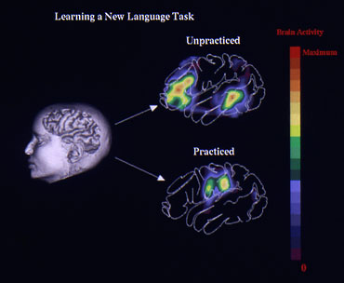

Slide 24
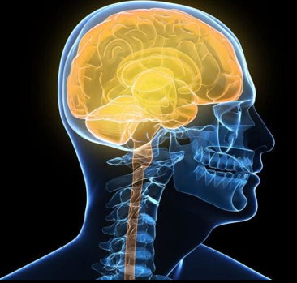
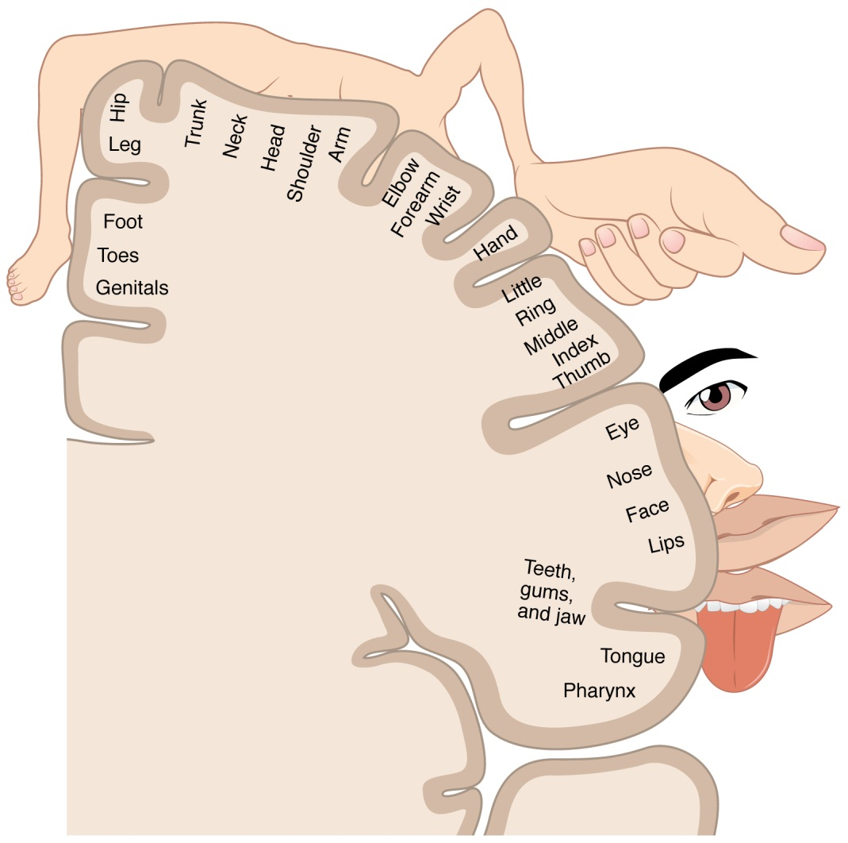
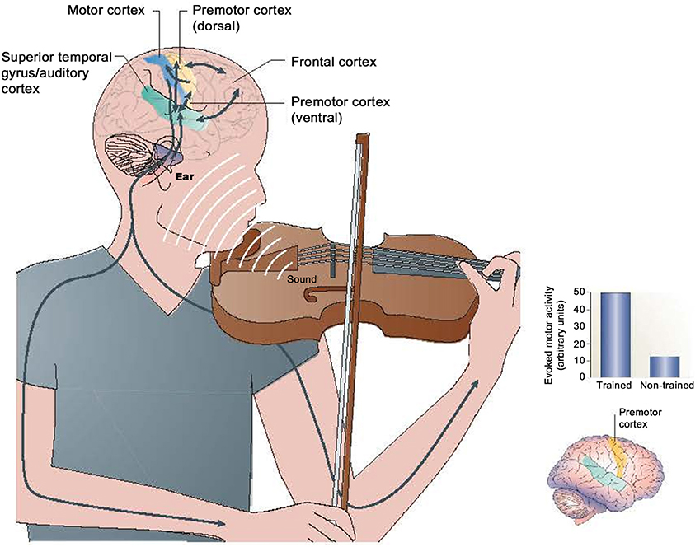
Experience → Changes in the Cerebral Cortex From Learning How To Play the Violin

Slide 25

If we teach today’s students
as we did yesterday
-- John Dewey
then we rob our students
of tomorrow.

Slide 26
The Knowledge Explosion
“The sum total of humankind’s knowledge doubled between 1750 and 1900. It doubled again between 1900 and 1950, again from 1950 to 1960, again from 1960 to 1965. It’s been estimated that the sum total of humankind’s knowledge has doubled at least every five years since then.
It’s been further projected that by the year 2020, knowledge or information will double every 73 days.”
Dr. James Appleberry - President, American Association of State Colleges and Universities

Slide 27
How Does the Brain Learns Best?
The human brain has evolved to learn most efficiently by doing
(not by listening, watching or keyboarding)

Slide 28

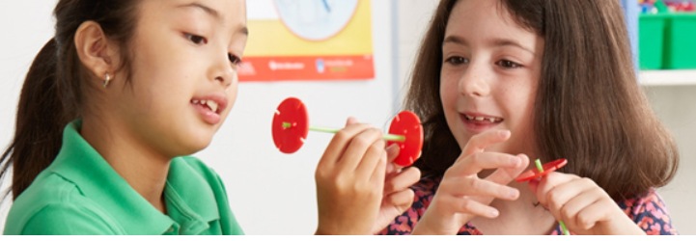
20+ Years of Research in Cognitive Science: High Impact Learning Strategies
337 pages
People learn and remember best through real-world first-hand experiences, not through memorization.
Children are born investigators.
We attempt to “make sense” of all incoming stimuli through the senses, visualization, and through formal language development.

Slide 29
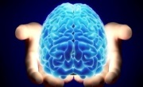
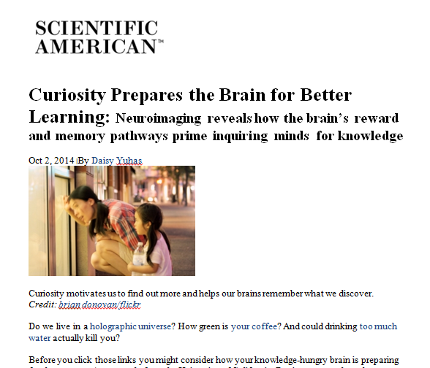
Phenomenon-based Science
(Experience-based Learning)
Pheno-BL is grounded in research indicating that learning is enhanced when students
are motivated by curiosity
get physically involved
receive ongoing feedback
from the activity itself
(not from the teacher,
and not from the test).

Slide 30
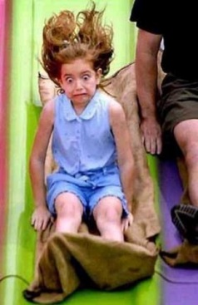
PERC³S
There are five BC elements that the human brain seeks while processing incoming stimuli for personal “meaning,” which makes the information “memorable” and worth remembering.
  Patterns (derivative of visual experience)
  Emotions
  Relevance
  Context, Content, and Cognitively-appropriate
  Sense-making → models
The brain examines all learning experiences through the lens of PERCS → determines how much we remember, how long we remember it, and whether or not we understand it enough for subsequent application (transfer of knowledge)

Slide 31
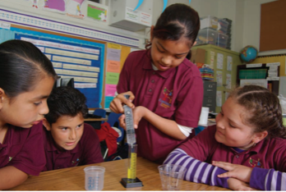
How Do Children Learn Best?
Give them something to do?
Give them something to think about?
Give them something to talk about? (BBK)
4. Whenever possible, have young students first draw what they will later write about (using the pictures in the “mind’s eye”)
5. After students do, think, talk about and draw the target concept (experience it), then we can say that they “know” it.

Slide 32
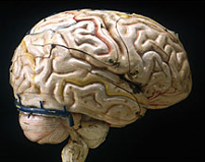
Kolb’s Learning Styles theory
(focuses on perception and processing)
Concrete Experience (CE)
Learning from 1st hand experiences/
personal involvement (investigations/senses)
Idea formation: observations based on experience
recognizing patterns/systems
Applying the new knowledge (discovered) in a new context or experience (“global understanding”)
→
Reflective Observation (RO)
Active Experimentation (AE)
Learning by
watching/reviewing
dialogue/listening (visual, verbal, & mental models – “sense makers”)
Asking new questions -
"what would happen if“ (knowing the variables to control and investigate)
→
Abstract Conceptualization (AC)
Learning by consolidating ideas (logic/analysis),
reading and thinking; difficult without 1st hand experience
(sow the seeds of innovation)

Slide 33
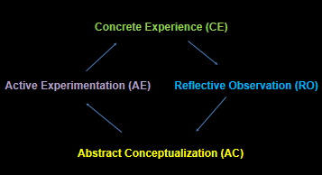
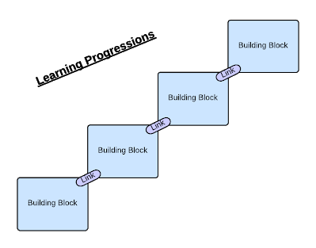

Experiential Learning
Via the AC feedback loop, we ponder what we might do differently next time, and then engage in the same or a similar experience once more - application (AE) → “Practices” → with repetition → predictions of the future (patterns), which is what our complex brain evolved for → survive.
Learning progressions

Slide 34
Experiential Learning
What do skilled performers do following any performance?
…a toddler learning to walk …a professional ballet dancer … symphony musician …scientist …an engineer
We visually and verbally analyze our own performance (via the hippocampus), primarily…
  the information that we took in (input from the senses),
  how we responded to the challenge and the prevailing environmental circumstances (output via our body)
  where we need to improve, and how we can improve (a cognitive/thinking process, which takes place in the frontal lobes -- preplanning for the “next time” – transfer what we have learned to subsequent encounters under similar conditions).

Slide 35
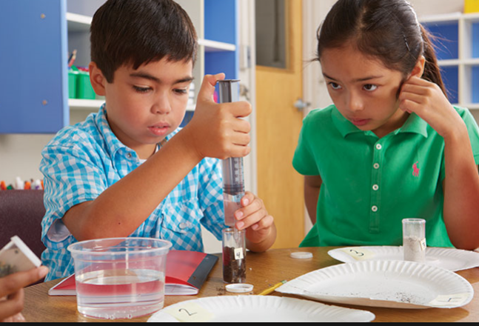
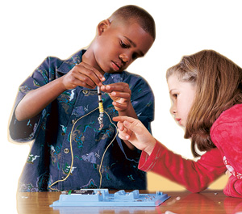
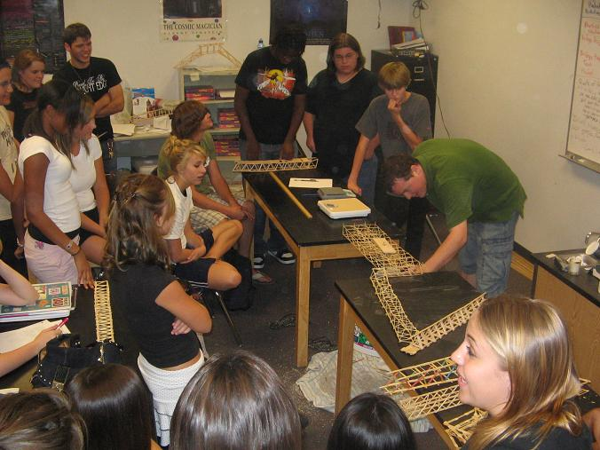
Hands-on Learning,
STEM/STEAM/ST²REAM,
PBL, Deep-Subject
Investigations →
Body-Brain Engagement
Guess what I did today?
Initial learning is far more “activity-dependent”
than it is information-dependent

Slide 36
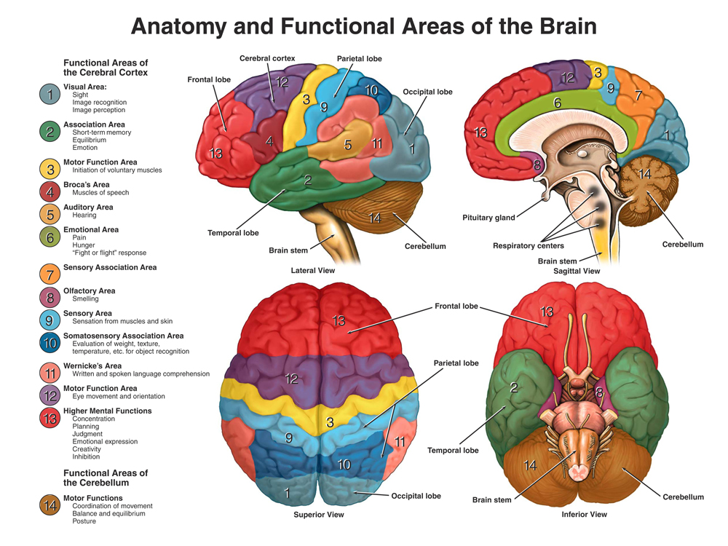
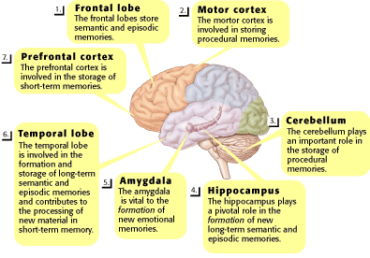
The Areas of the Brain Developed through STEAM:
“Whole Brain” Thinking
seeing
connecting
doing
talking
listening
socializing
touching
smelling
feeling
experimenting
interpreting
planning/ creating
“making”
Cumulatively = “Understanding”
Apply to predictable & unpredictable

Slide 37
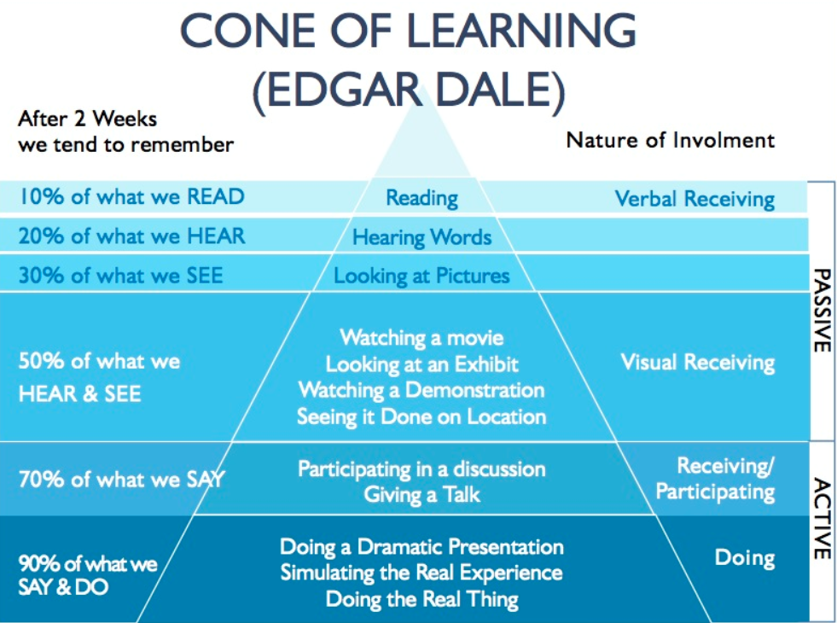


Slide 38

Type of Learning Memory Formation Deep/Long-lasting Learning Educational Time/Dollars
Experience (Easily formed cortical representations) (Long-term learning outcomes) Invested
First-hand learning Highest Highest Lowest
Real-world, real-time ↑ Interactions → episodic memory Direct experience yields Meets the intended
Hands-on, minds-on “Leveled” readers are unnecessary the highest levels of learning learning objectives at
and hearts’-in Multidimensional/multidisciplinary and memory results the same or a lower cost
Interpersonal/social aspect Multi-sensory (multiple stimulation) Effortless reflections/questioning to the school system
Direct experience Conversational descriptions emerge High transferability
Note-booking Highly concrete with multiple exposures Learner-centered
Problem solving Multi-modal. Develops highly elaborate
Excursions (e.g., to the wetlands) sensory memory records (easily extended)
Kinesthetic (“muscle Reading ability/language background
memory”) become irrelevant (non-linguistic)
↑ Thinking skills (e.g., cause-and-effect)
provides immediate learner feedback
Second-hand learning Moderate Moderate Moderately high
Pictures/diagrams/graphs Understanding is heavily dependent Effective for visual learners Providing costly
Computer simulations/models upon established knowledge and Fragmented recall tech equipment is
Teacher demonstrations prior learning (no earlier experiences Generates student interest of schools (and often
Virtual reality/multimedia → no cognitive basis for making “Digital Divide” from impoverished
Videos/DVDs/Internet conceptual connections) homes)
Third-hand learning Lowest Lowest Highest
Reading Contingent upon academic or Students can reproduce content Yet this form yields the
Lecture personal background knowledge but transferability and application lowest cognitive returns Language-based vocabulary/ suffer when the situational context on teaching time and
Semantics/definitions are crucial is altered (remains “surface level school $$ invested
Highly conceptual. Easily assessed knowledge.”) Teacher-centered
First, Second, and Third-hand Learning Models
Type of Learning Memory Formation Deep/Long-lasting Learning Educational Time/
Experience (Easily forms cortical representations) (Long-term learning outcomes) Dollars Invested
First-hand learning Highest Highest Lowest
Real-world, real-time ↑ Interactions → episodic memory Direct experience yields Meets the intended
Hands-on, minds-on “Leveled” readers are unnecessary; the highest levels of learning learning objectives at
and hearts’-in Multidimensional/multidisciplinary; and memory results; the same or a lower cost
Interpersonal/social Multi-sensory (high stimulation); Effortless reflections/questioning; to the school system
Direct experience Verbal descriptions merge with AL; High transferability; and,
Note-booking Highly concrete with multiple exposures Learner-centered
Second-hand learning Moderate Moderate Moderately high
Pictures/diagrams/graphs Understanding is heavily dependent Effective for visual learners; Requires costly tech
Tech./simulations/models upon established knowledge and Fosters fragmented recall; tools/equipment/support
Teacher demonstrations prior learning (no earlier experiences Generates student interest; (cannot expect tech. to
Virtual reality/multimedia or cognitive basis for making “Digital Divide” be available for students
Videos/DVDs/Internet conceptual connections) in impoverished homes)
Third-hand learning Lowest Lowest Highest
Reading Contingent upon academic lang./ Students can reproduce content Yet this form yields the
Lecture personal background knowledge; but transferability and application lowest cognitive returns Discipline-based vocabulary; suffer when the situational context on teaching time and Semantics/definitions are crucial; is altered (remains “surface level school $$ invested Highly conceptual; and, knowledge.”)
Easiest method to teach and assess Teacher-centered
Brain-considerate Learning kenawesson@aol.com (408) 323-1498

Slide 39
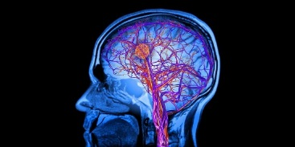

Developing Literacy through Experiential Learning
All children, and particularly children from language- impoverished backgrounds, benefit most from learning environments that are:
Experience-rich
language-rich (“serve and receive” verbal interactions -- primary caregiver feedback)
print-rich (classrooms with word walls, writing samples, books of every genre, real-world objects, etc., and homes where parents/siblings model that reading and dialogue have tremendous power and value)
from meaning-to-print
not from print-to-meaning

Slide 40
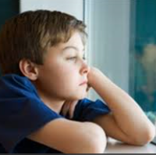
Poverty, Neglect and Education
For the students who lack the educational support at home, they will need an extra dosage of language experiences when they arrive at school if we hope to boost their AL.

Slide 41

Experiences = Cognitive Rehearsals
(→ consolidation)
When playing with objects, learners are simultaneously manipulating/playing with ideas (internal dialogues attach words and meaning to actions – the “mind’s eye”) building the brain’s fundamental circuitry
Exploring and experimenting involve examining relationships, interactions and systems, where learners formulate their own personal “theories” (mental constructs)
Thinking is a cognitive rehearsal for discourse
Discourse is a cognitive rehearsal for writing (phonological loop or “inner voice”)

Slide 42
Cognitive Rehearsals
Playing with objects and ideas, exploring and experimenting, thinking, talking, and writing become cognitive rehearsals (background knowledge) for reading.
Writing and reading clarify one’s thoughts, generate coherent thinking, and cultivate precision in expressing one’s inner thoughts
(→ LT/P memory consolidation)
Discourse and writing become cognitive rehearsals for assessment
Source: Kenneth Wesson (2011). Education for the Real World: six great ideas for parents and teachers.
Brain World, Issue 2, Volume 2.

Slide 43
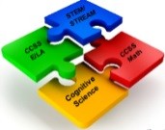
Regardless of discipline, all student writing should be grounded in concrete ideas, where young learners have first-hand experiences with the ideas/concepts about which they will later write.

Slide 44


Argument from Evidence
“One characteristic of high-performing schools is an emphasis on teaching non-fiction writing.”
(Reeves, D.B. (2003). High Performance in High Poverty Schools: 90/90/90 and Beyond. Center for Performance Assessment. Denver, Colorado)
(Another key factor in high-performing schools is an unwillingness to accept state or district test scores as the sole measure of student achievement.)

Slide 45
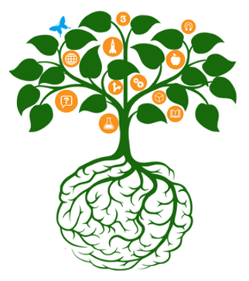
“I have a discipline problem in my classroom.”
No! You have an engagement problem…
Experience: Active and engaged students, …
1. Are less likely to disrupt
2. Earn higher grades
3. Feel more confident about learning to learn
4. Are willing to accept more challenges
5. Retain information longer
6. Are far more likely to become life-long learners
(Brewster, 2000)

Slide 46
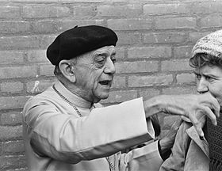
Confronting the Hard Questions
“When I fed the hungry, they
called me a saint.
When I ask why are so many
people hungry, they called me
a communist.”
– Hélder Câmara, Brazilian Catholic Archbishop (1909-1999)

Slide 47

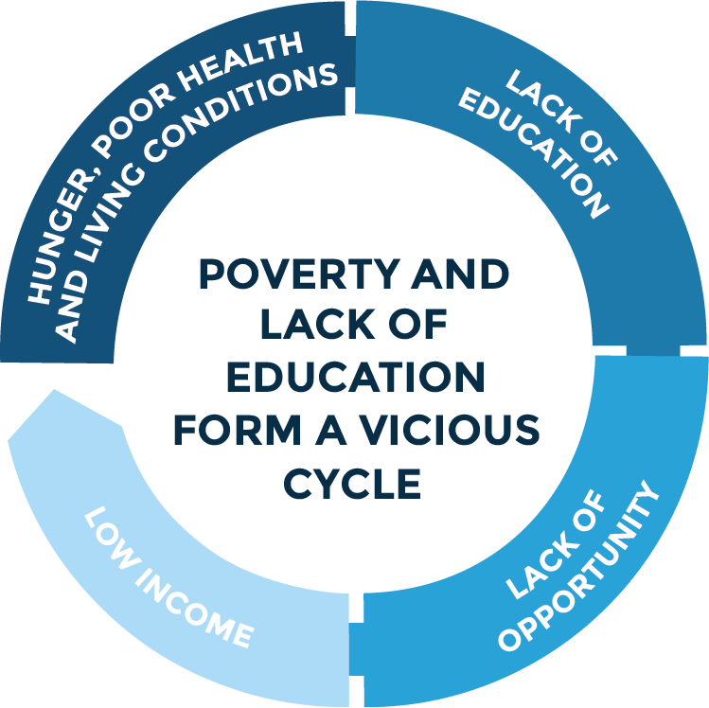
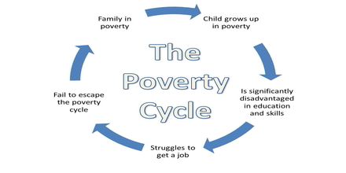
↑ Discrimination + ↓ Education = Poverty
Poverty → illiteracy → poor employment opportunities → low-paying jobs → more poverty and economic vulnerability → restricted to living in virtually uninhabitable slums → a seemingly endless cycle of cascading deleterious consequences

Slide 48
Access and Equity
Targeted groups (“High-need” – Different needs)
Non-standard English Learners
English Learners
Ethnically Diverse Learners
Foster Youth
Girls and Young Women (Gender Equity)
Advanced Learners and Gifted Learners
Students with Disabilities
Students Experiencing Difficulties with Literacy in Science and Engineering
Students Living in Poverty (the single common thread)

Slide 49
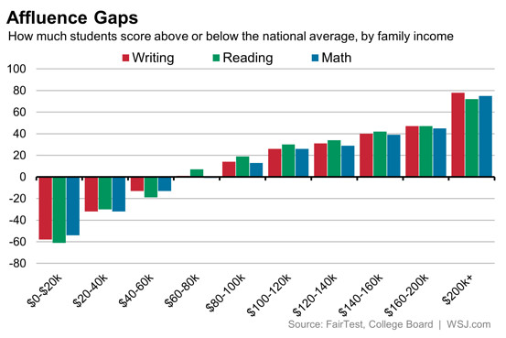
Access and Equity
More than 1 in 5 of California’s children and youth live in poverty (U.S. Census Bureau 2012). In addition to its negative academic correlation, there are psychologically and physically stressful circumstances that accompany poverty.

Slide 50

Poverty, Environment, and Brain Development
Factors contributing to cognitive deficits, as well as mild to profound brain damage include the following:
• inadequate prenatal care
• poor perinatal nutrition
• smoking during pregnancy
• second-hand smoke
• lead poisoning from lead pipes and lead-based paints
• premature births
• babies with low birth weights
• prenatal substance exposure (recreational drugs)
“Health disparities” with ↑ predictable consequences

Slide 51
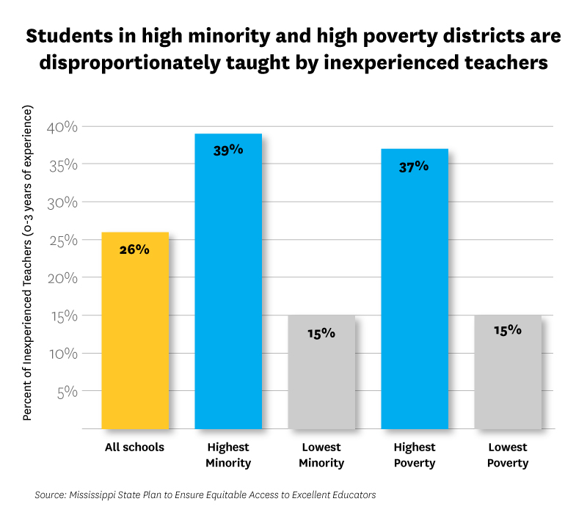
A ↑ %age of Teachers with 15+ years Experience = $3M more in Salaries:
“Return on Investment”
Very few
Honors
AP
IB
Courses
(STEM)
SAT
College admissions

Slide 52
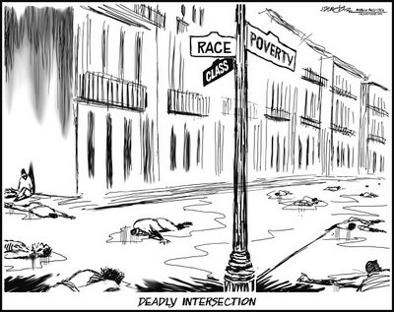
Poverty and Brain Development
Developmental neurobiology, early brain development (zero-three), and the impact of negative environmental circumstances on brain development (particularly prenatal, postnatal, infant, toddler, and pre- adolescence) can influence learning capabilities.

Slide 53

The Heritability Fallacy
By Moore and Shenk
Enriched
environment
Impoverished
environment
The term ‘heritability,’ as it is used today in human behavioral genetics, is one of the most misleading in the history of science. Contrary to popular belief, the measurable heritability of a trait does not tell us how ‘genetically inheritable’ that trait is. Further, it does not inform us about (1) what causes a trait, (2) the relative influence of genes in the development of a trait, or (3) the relative influence of the environment in the development of a trait. Because we already know that genetic factors have significant influence on the development of all human traits, measures of heritability are of little value, except in very rare cases. We, therefore, suggest that continued use of the term does enormous damage to the public understanding of how human beings develop their individual traits and identities..

Slide 54

IQ and “Achievement” Testing?
“Kenneth Wesson, a founding member of the Association of Black Psychologists wrote brilliantly,”
“Let’s be honest. If inner-city children consistently outscored children from wealthy suburban homes on standardized tests, is anyone naïve enough to believe that we would still insist on using these tests as indicators of success?”
“The Big Picture”
by Dennis Littky

Slide 55


A biological brain
and an emotional brain

Slide 56
S.A.I.L.
The environmental preconditions that should be experienced by students prior to initiating formal instruction include...
S afety (physical and emotional)
A cceptance (no “put-downs”)
I nclusion, interactions and involvement (interpersonal/social aspect of memory formation)
After satisfying these prerequisite neurophysiological and hierarchical conditions, students are biologically ready for
L earning (students feel their immediate environment is secure enough for them to take risks, explore and discover).
Source: Kenneth Wesson (2011). Education for the Real World; Six great ideas for parents and educators. Brain World, Issue 2, Volume II Winter 2011.

Slide 57



June 2018
Saber-toothed Tigers and stressed-out students: an examination of the neuroscience behind safe, secure learning environments
– by Kenneth Wesson
“There is a growing body of neurological evidence supporting the notion that if students do not feel safe, secure and comfortable in a learning environment, their ability to learn is severely compromised, regardless of the quality of instruction or the level of instructional expertise demonstrated by the classroom practitioner.”
Safety is a
learning requirement
Maslow’s Hierarchy of Needs

Slide 58


The Neuroscience Behind Safe,
Secure Learning Environments
To a learning brain, new curricula, the latest i-Pad, and the best-trained teacher
will not offset the absence of physical and emotional safety.
“…stressed-out brains (in students or adults) are physically incapable of establishing and maintaining the requisite neural connections inside the brain that are necessary to support content-related learning as well as long-term memory formation.”
Safety is an
Equity Issue

Slide 59
Toxic Stress
Chronic stress or “toxic stress” can
1. lead to the physical destruction of neurons in the hippocampus (an area in the brain associated with learning/memory storage.)
2. modifies the hippocampus, reducing a child’s learning capacity (Vythilingam, 2002)
3. shrinks neurons in the frontal lobes decreasing one’s executive functions - planning, judgment, controlling impulsivity (Cook & Wellman, 2004).

Slide 60


Children who have chronic safety concerns also tend to underperform academically (Pratt, Tallis, & Eysenck, 1997)

Slide 61
A biological brain
and an emotional brain
Dimensions of Brain Health
Physical Health
Cognitive Health
Mental Health
Social Health
Nutritional Health
Emotional Health

Slide 62

Why Social-emotional Learning Matters
29%:
Students feel like their school provides a supportive, encouraging environment
11%:
Average gained on standardized testing when participating in an SEL program
11%:
Average increase in GPA for participants in one SEL program
83%:
Students make gains when participating in an SEL program with an academic component
SEL programs improve behavior and attitudes toward school and prevent substance abuse
Source: Collaborative for Academic, Social and Emotional Learning (casel.org)

Slide 63

Emotions and Engagement
1. Students find that what they care about becomes easiest to learn; they remember best what they understand.
2. Students don’t care what you know, until they know that you care. You can pay people to teach…
3. “Students learn as much for a teacher as they do from a teacher.” Linda Darling-Hammonds

Slide 64
Emotional Intelligence in Education
Learning requires effort, and one of the best predictor's of students’ effort and engagement in school is the relationships that they have with their teachers (Osterman, 2000.)
Students function more effectively when they feel respected and valued and function poorly when they feel disrespected or marginalized (National Research Council, 2004)

Slide 65
Students may forget what you said, but they will never forget how you made them feel.
-- Carl W. Buechner

Slide 66


Each year, new findings in cognitive psychology and neuroscience will be infused into teacher preparation, curriculum, instruction, student assessment, and the classroom environment. The works of Howard Gardner (“Multiple Intelligences”), Daniel Goleman (“Emotional Intelligence”), Kenneth Wesson (“Brain-considerate Learning”), and others have already been influential in reshaping the independent school classroom, while programs like Mel Levine’s Schools Attuned are assisting educators in using neurodevelopmental content in their classrooms to create success at learning and to provide hope and satisfaction for all students.
Forecasting Independent Education to 2025
-- NAIS

Slide 67

“Reflect and Connect”
“We don’t learn from experience, we learn by reflecting on it.”
        -- John Dewey
• What was the most valuable idea that you learned this afternoon?
Please write down 2 “I will” statements: How will you use the information shared today, when you return to your school district?

Slide 68


Special thanks to School Specialty and
Michael Yorio, President
SSI Guardian

Slide 69


Contact Information:
Kenneth Wesson
Educational Consultant: Neuroscience
(408) 323-1498 (office)
(408) 826-9595 (cell)
San Jose, CA
Ken.wesson@schoolspecialty.com
sciencemaster.com

