Slide 1
CRC Entrepreneurship Program
Cosumnes River College: 50+ years, 14,000 headcount, Southern Sacramento, 1 of 4 colleges of Los Rios CCD
Entrepreneurship program started with a Chancellor’s Circle Grant in 2013
Explored best practices in Entrepreneurship
Developed Stackable Credentials:
9-unit Certificate of Proficiency (3 courses)
18-unit Certificate of Achievement (6 courses)
30-unit AA Degree in Entrepreneurship/Small Business (10 courses)

Slide 2
CRC Entrepreneurship Program
Stackable Credentials
9-unit Certificate of Proficiency (3 courses)
BUS 215, BUS 300, BUS 350
18-unit Certificate of Achievement (6 courses)
BUS 215, BUS 300, BUS 350, BUS 340, MKT 300, + 1 Elective
30-unit AA Degree in Entrepreneurship/Small Business (10 courses)
BUS 215, BUS 300, BUS 350, BUS 340, MKT 300, ACCT 301, ECON 302, + 2 Electives + 1 Elective

Slide 3
CRC Partnership with Elk Grove USD
MOU signed September 2014 among CEOs of CRC, EGUSD, and CSUS establishing Sacramento Pathways to Success, timing of opening of new Elk Grove Center (EGC), to provide (high level):
Rigorous education for each child for college or job and career training
Clear and understandable roadmap to college and career for each child
Opportunities in career and technical education and transfer to four-year degrees (and beyond).
Entrepreneurship Pathway with Cosumnes Oak, Sheldon High, Valley High of EGUSD, to provide (low level):
Entrepreneurship courses at CRC, EGC or HS campuses.

Slide 4
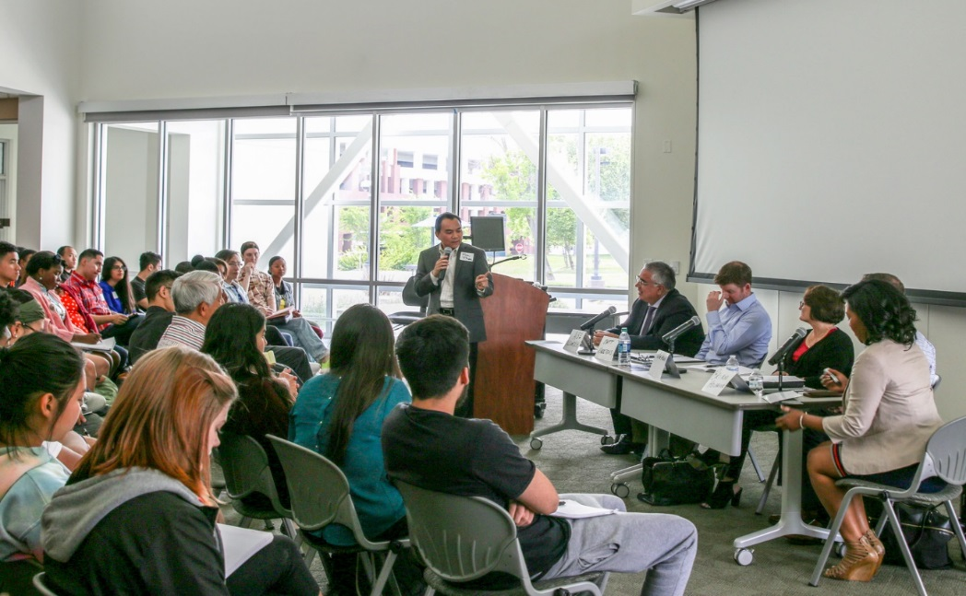
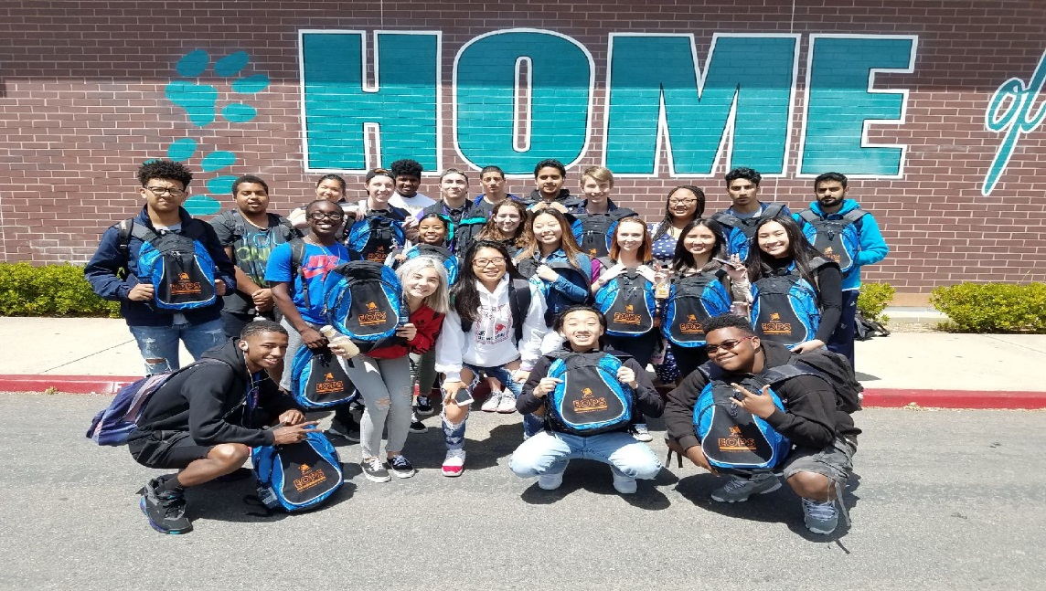
CRC Entrepreneurship Activities
Annual Entrepreneurship Seminar
Annual Business Plan Competition
Tesla Presentation to CRC community

Slide 7
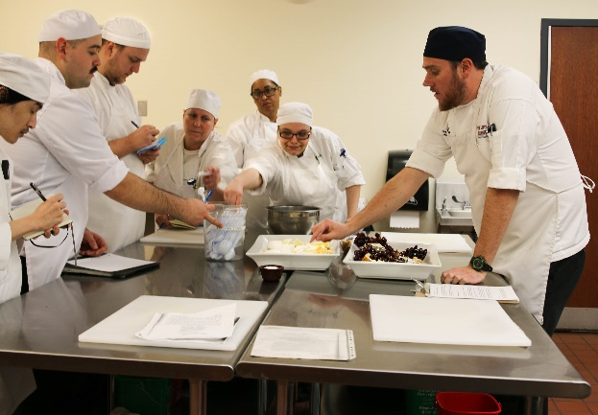
Embedding Entrepreneurship Across Disciplines
Developed curriculum in culinary arts to include business/entrepreneurship classes (5 business classes)
Designed to ensure that those who receive culinary degree have business skills to start and manage their own food/catering business.
A.A. degree in Restaurant and Food Service Entrepreneurship
Upcoming: Construction management & Music
Program pathways with EGUSD high schools

Slide 9
Q & A
Encourage participants to share best practices by other colleges and high schools
Contact information:
Man Phan, Ed.D
Business Professor and Department Chair
Cosumnes River College
Phone: 916-691-7559
Email: phanm@crc.losrios.edu

