Slide 1
Examining Social-Emotional Learning: Equity, Student Achievement, and Self-Efficacy
Darryl J. Brown, Ed.D., Coordinator III, Charter Schools Office, Division of
Accountability, Support and Monitoring
Kathryn Edwards, Ph.D., Coordinator III, Equity Assessment and Curriculum Support, Division of Curriculum and Instruction

Slide 2
CAAASA/CCEE PLN
California Association of African American Superintendents and Administrators
California Collaborative for Educational Excellence: a state agency created in 2013 under California’s Local Control Funding Formula (LCFF)
Offers evidence-based support to county offices of education, school districts, and charter schools so they can take ownership in continually improving learning for all students.
Supports 58 Professional Learning Networks statewide with participation of 300+ LEAs

Slide 3
CAAASA/CCEE PLN
Participating LEAs: Los Angeles COE, Napa COE, San Diego COE, Compton USD, Fresno USD, Lynwood USD, Pittsburg USD
Areas of Strategic Intervention:
Improve Student Attendance (parent/family/community engagement; social emotional support)
Improve Quality of Instruction (retention and recruitment of qualified teachers; evidence-based teaching practices; professional development; access to A-G courses and college and career readiness resources)
Improve School Climate (working toward social justice through reductions of suspensions/expulsions; health/mental health service; positive discipline approaches)

Slide 4
Objectives
Create deeper understanding of educational equity and its impact on student achievement and social-emotional learning.
Share research on the CORE Districts implementation of Social-Emotional Learning (SEL) programs and strategies and the impact on African-American students’ perceptions of SEL capacity, school-connectedness, and climate.
Develop intentional school-wide strategies that support students’ sense of self-efficacy and reduce barriers to student equity.

Slide 5
What’s Your Why?

Slide 6
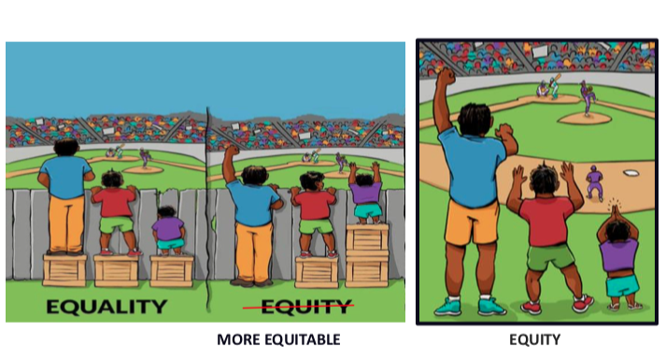
Equity vs. Equality

Slide 7
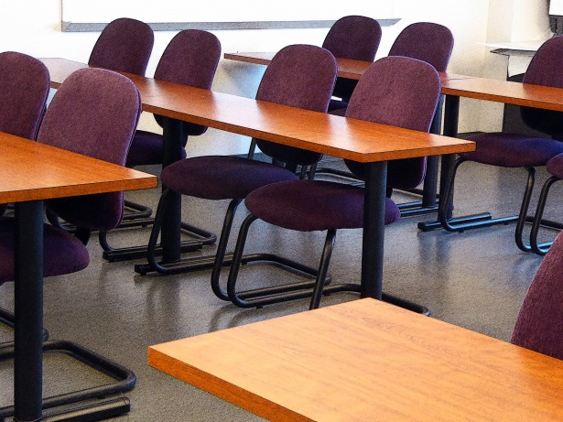
Equity means recognizing the historical and systemic disparities in opportunities and outcomes
and providing the resources necessary to address those disparities.
Education Trust West, Ryan Smith

Slide 8
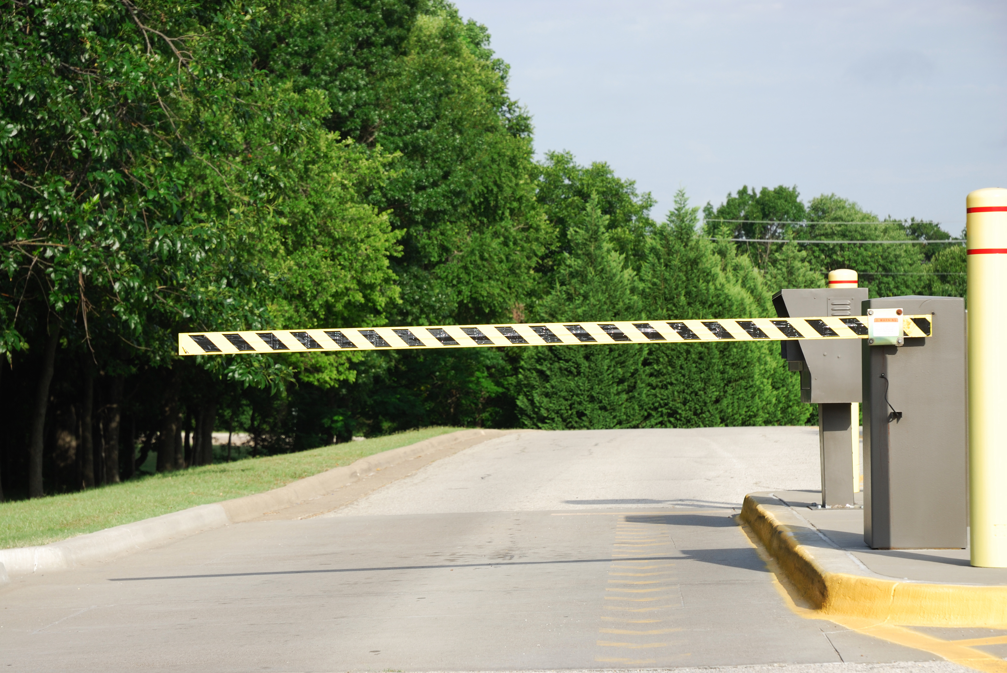
Barriers to Equity
EQUITY

Slide 9
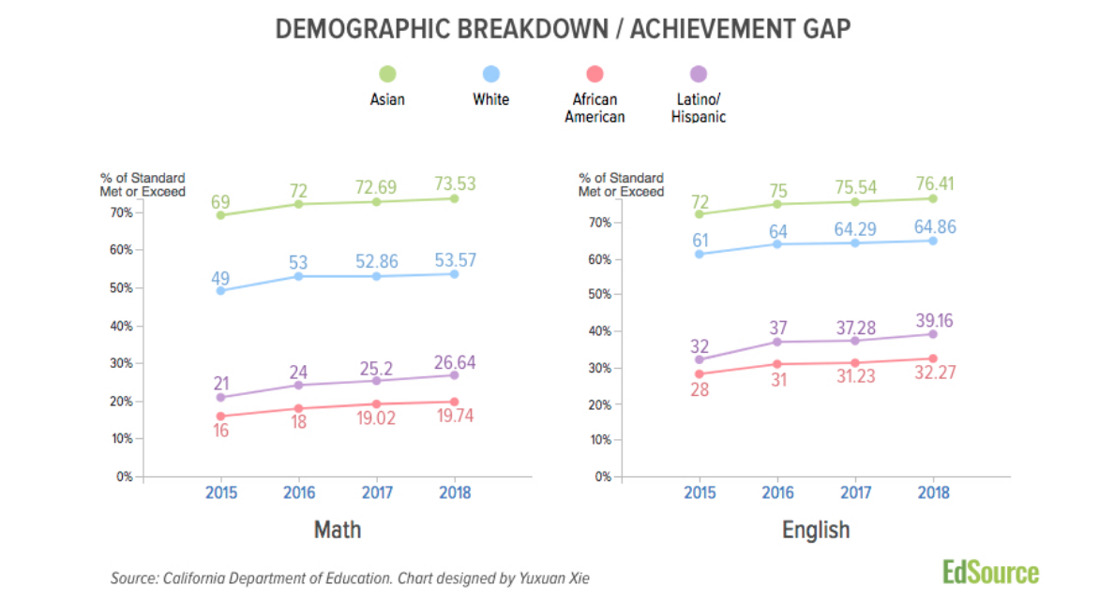
CAASPP Demographic Data – 2015-2018

Slide 10
Black Children in California are . . .
Education Trust West, Black Minds Matter, 2015

Slide 11
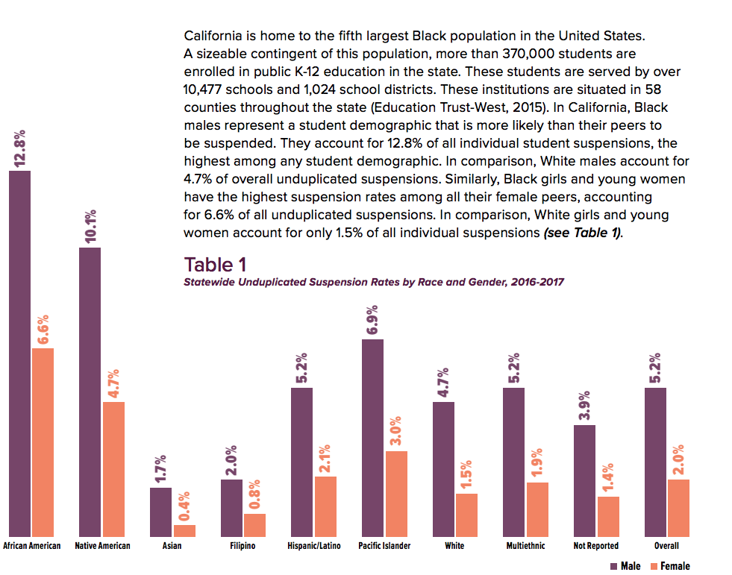
CA Suspensions by Race and Gender, 2016-17
Get Out: Black Male Suspensions in California Public Schools,2018

Slide 12
Statewide Suspension by Type, CA, 2016-17
Black males are most likely to be suspended for a “violent incident” where no injury occurred (i.e., a fight). This accounts for 55% of all suspensions for Black males.
Get Out: Black Male Suspensions in California Public Schools, 2018

Slide 13
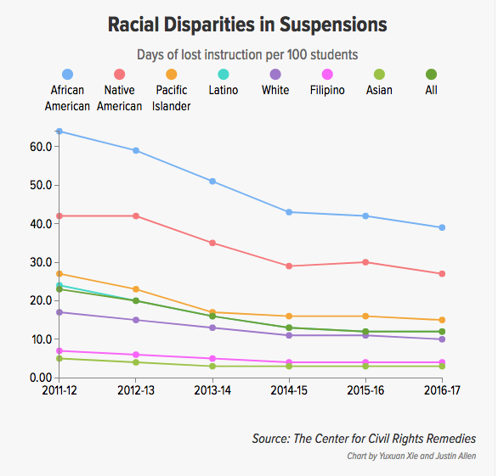

Slide 14
Percent of 7th, 9th, and 11th Graders Reporting Feeling a High Level of School Connectedness, Supports, and Safety by Race and Ethnicity, 2013-15
School Climate and Safety
 | American Indian/Native American | Asian | Black | Latino | NHOPI | White | Multiracial
Feel Highly Connected to School | 48% | 52% | 37% | 42% | 45% | 57% | 45%
Feel Highly Cared for by Adults at School | 32% | 33% | 36% | 29% | 34% | 41% | 33%
Feel Safe or Very Safe at School | 68% | 71% | 59% | 61% | 64% | 75% | 65%
Source: California Healthy Kids Survey, 2013-2015
Notes: Includes percentage of publics school students in grades 7, 9, 11, and non-traditional students reporting high level of agreement with each statement. Reflects data from the 2013-14 and 2014-15 school years. Estimates are weighted proportions from the CA Healthy Kids Survey based on a sample of participating school districts in the county. School Connectedness is a summary measure that includes student reports of being treated fairly, feeling close to people, feeling happy, feeling a part of school and feeling safe at school

Slide 15
15% of all students, nationally and 12% in California
Chronic absenteeism is higher in schools with 75% or more of students living in poverty.
School safety and health issues, e.g. asthma, are contributing factors.
Less likely to read by 3rd grade and more likely to drop out in high school and show less persistence in college
EdSource, September 7, 2018

Slide 16
–
Edwin Javius, EdEquity, 2018
Notes:
Use appropriate instruction
Ensure sufficient learning for all students
Equitable access to the content areas
Increase school attendance to decrease splinter skills
Improved behavior that increases student learning

Slide 18
“While the challenge facing African American students is well documented, few studies have explored the link between SEL practices and outcomes for historically marginalized students.”
Enacting Social-Emotional Learning:
Practices And Supports Employed in CORE Districts and Schools
CORE-PACE Research Partnership

Slide 19
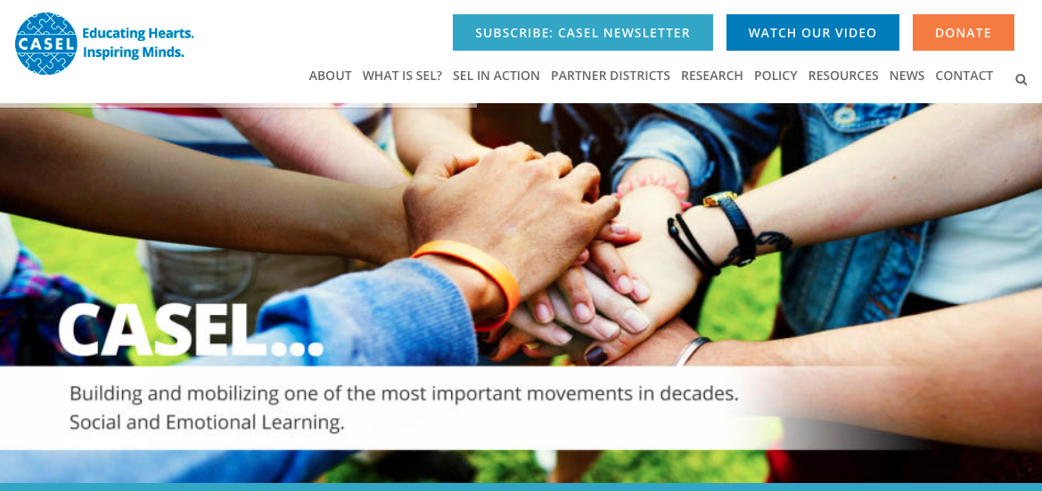

Slide 20
CASEL Definition of Social-Emotional Learning
Social and emotional learning (SEL) is the process through which children and adults acquire and effectively apply the knowledge, attitudes, and skills necessary to understand and manage emotions, set and achieve positive goals, feel and show empathy for others, establish and maintain positive relationships, and make responsible decisions.

Slide 21
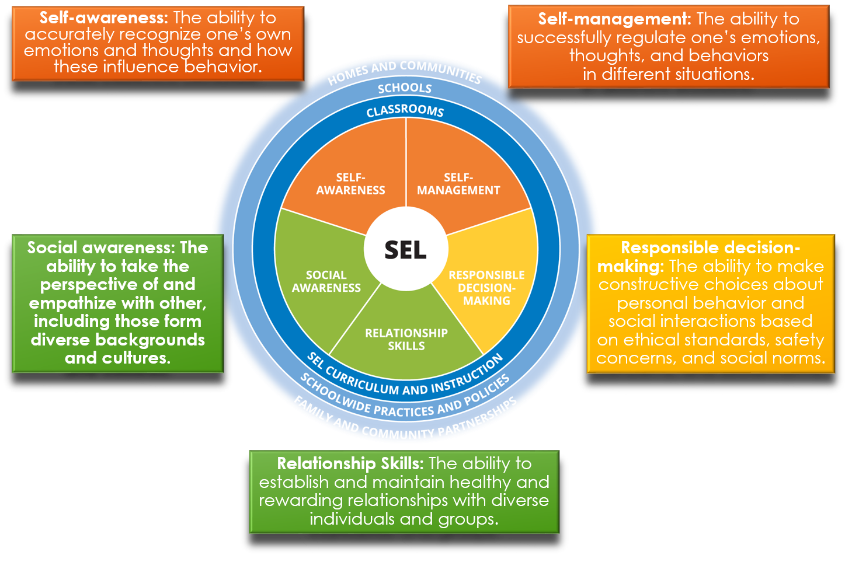

Slide 22
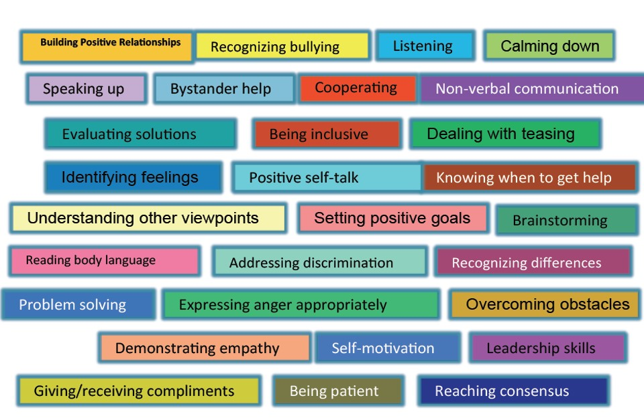
SEL Skills

Slide 23
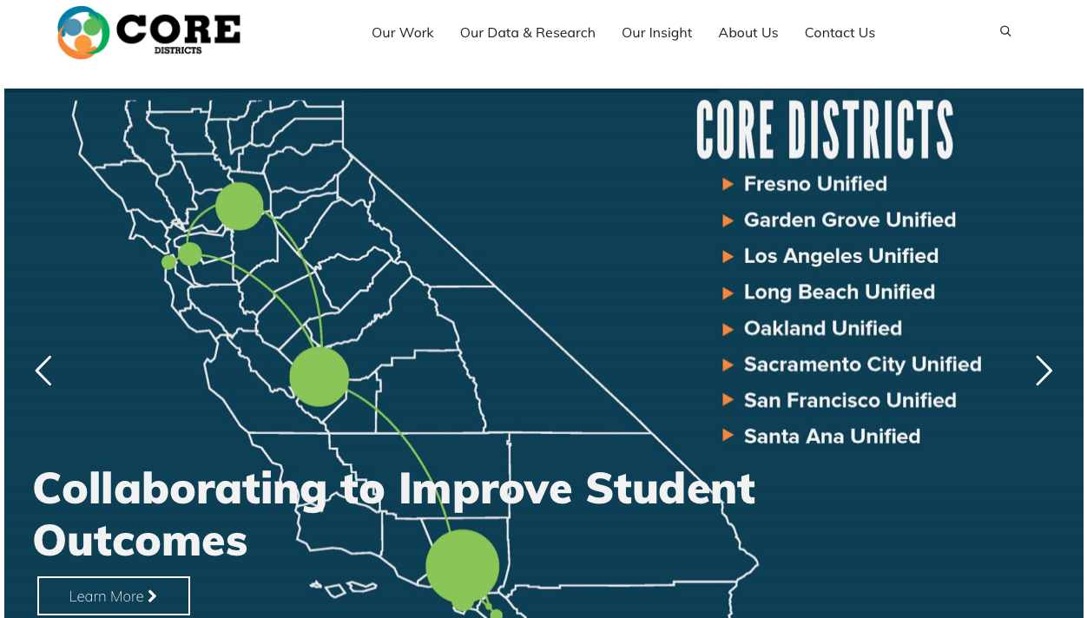

Slide 24
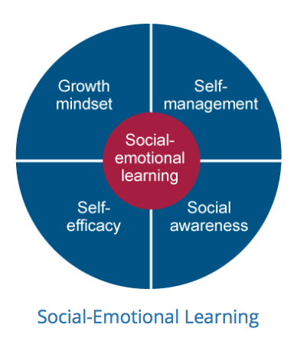

Slide 25
CORE Districts SEL Implementation
Analysis of 2015 field survey administered to 400,000 students grades 4-12.
Growth Management, Self-Efficacy, Self-management, Social Awareness
Analysis indicated strong statistical correlations between students’ social-emotional skills and concurrent academic outcomes.
(West, Buckley, Krachman, and Bookman, 2017)

Slide 26
Correlating SEL with Academic Indicators
Elementary Schools | GPA | ELA test score | Math test score
Self-management | .62 | .82 | .79
Growth Mindset | .38 | .67 | .65
Self-efficacy | .61 | .60 | .56
Social Awareness | .33 | .58 | .53

Slide 27
Correlating SEL with Academic Indicators
Middle Schools | GPA | ELA test score | Math test score
Self-management | .65 | .85 | .85
Growth Mindset | .56 | .76 | .72
Self-efficacy | .60 | .67 | .65
Social Awareness | .55 | .74 | .71

Slide 28
Correlating SEL with Academic Indicators
High Schools | GPA | ELA test score | Math test score
Self-management | .41 | .52 | .49
Growth Mindset | .49 | .47 | .39
Self-efficacy | .23 | .12 | .18
Social Awareness | .44 | .74 | .74

Slide 29
Six School-Level Practices to Support SEL
Strategies to promote positive school climate and relationships
Supporting Positive behavior
Promoting student engagement
SEL-specific classroom practices and curriculum
Marshalling human capital resources in support of SEL
Measurement and Data Use

Slide 30
CORE/PACE SEL and School Climate/Culture
2014-15 SEL and Climate/Culture (CC) surveys
SEL Survey - Self-management, Growth Mindset, Self-Efficacy, Social Awareness
Climate/Culture Survey - Support for academic learning, sense of connectedness, perceived fairness of discipline rules and norms, safety
(Hough, H., Kalogrides, D., & Loeb, S. (2017)

Slide 31
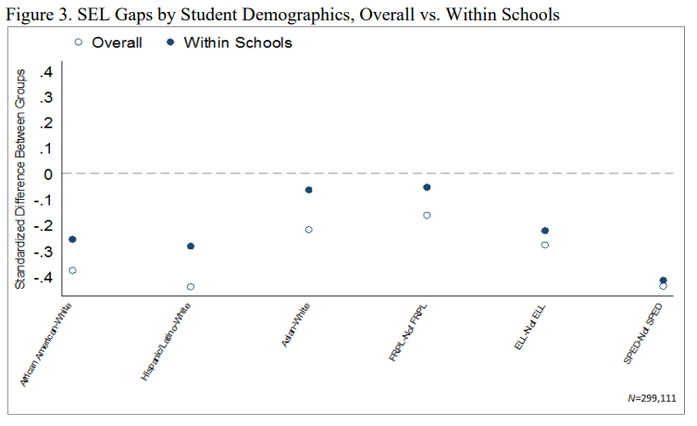

Slide 32
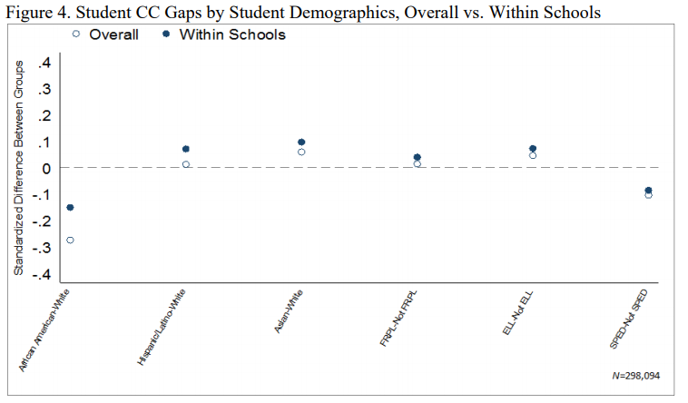

Slide 33
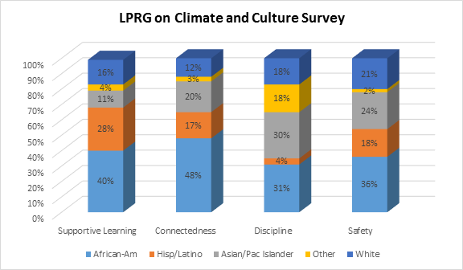
(Hough, Kalogrides, and Loeb, 2017)

Slide 34
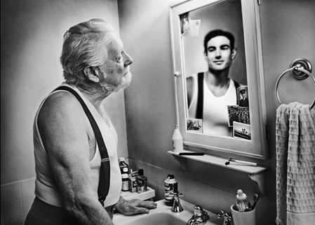
We do not really see through our eyes or hear through our ears, but through our beliefs.
-Lisa Delpit

Slide 35
Cultural Proficiency: An Inside-Out Approach to Difference
Assess Culture: Identify the differences among the people in your environment
Value Diversity: Embrace the differences as contributing to the value of the environment
Manage the Dynamics of Difference: Reframe the differences so that diversity is not perceived as a problem to be solved
Adapt to Diversity: Teach and learn about differences and how to respond to them effectively
Institutionalize Cultural Knowledge: Change the systems to ensure healthy and effective responses to diversity
Cultural Proficiency: A Manual for School Leaders, Lindsey, Robins, Terrell, Corwin Press, 2009

Slide 36
Barriers to Equity Outcomes through SEL : “Colorblindness”
Colorblind racism explains racial inequality as the outcome of nonracial dynamics.
The perception that race does not matter.
Many educators state that they don’t see color in an effort to treat all students the same.
(Bonilla-Silva, 2013)

Slide 37
The Impact of Colorblindness – AB 2635
AB 2635 was initially intended for the lowest-performing racial/ethnic group.
School districts will receive $300 million in 2018-2019 to support students with the lowest standardized test scores.
Passed the Assembly 76-0; amended when taken up by the Senate.
Reasoning was that it conflicts with Proposition 209.

Slide 38
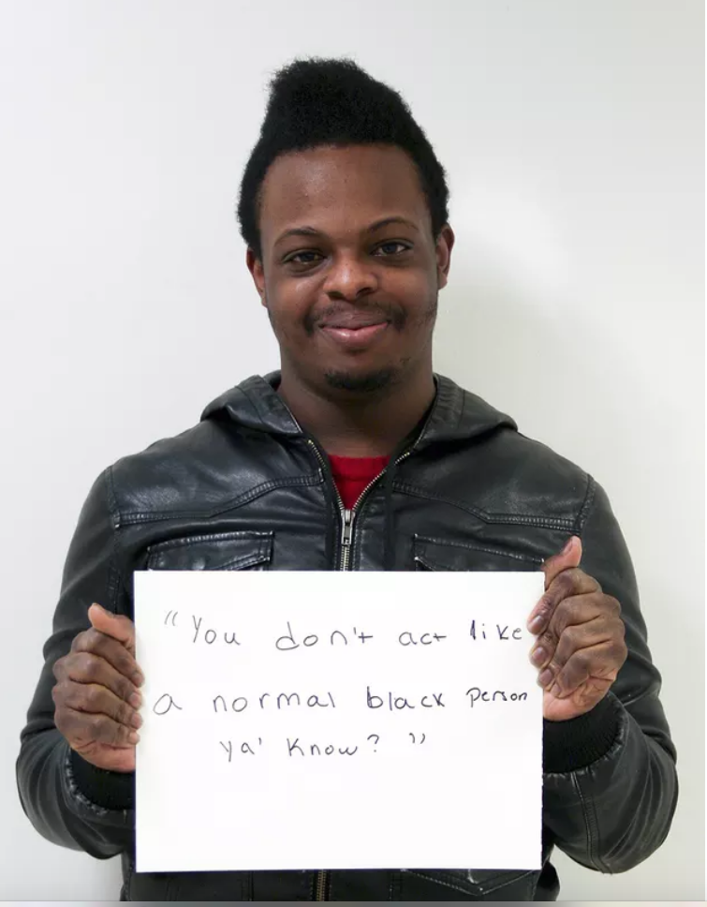
Barriers to Equity Outcomes through SEL “Microaggressions”
Everyday verbal, nonverbal, and environmental slights, snubs, or insults, whether intentional or unintentional, which communicate hostile, derogatory, or negative messages to individuals based solely upon their marginalized group membership.
- Derald Wing Sue, Ph.D

Slide 39
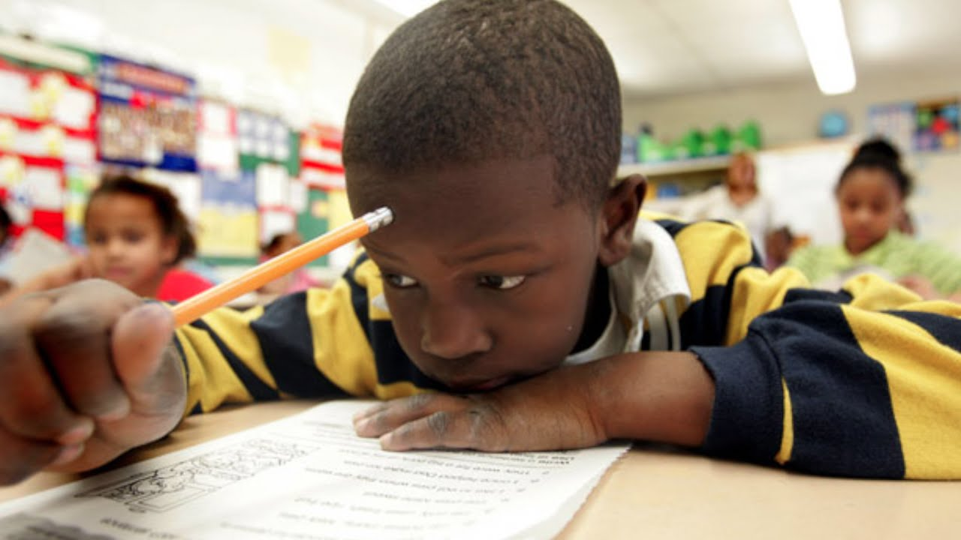
Barriers to Equity Outcomes through SEL “Stereotype Threat”
Self-evaluative threat
Creates anxiety, decrease in working memory capacity and physiological stress
Facilitated through Implicit Bias
(Steele, C. M., & Aronson, J.,1995)

Slide 40
Self-Efficacy
I got this!

Slide 41
Self-Efficacy
An individual’s belief in their ability to achieve an outcome. Self-efficacy reflects confidence in the ability to exert control over one’s motivation, behavior, and environment.
(Bandura, 1997)

Slide 42
Self-Efficacy Sample
2+2=?
2(1+3)=?
(3z+5)x(2z+7)=?
9x²-9x+2=0

Slide 43
Sources of Self-Efficacy
MASTERY EXPERIENCES
Previous experiences that promote an individual’s perception of success in future experiences.
VICARIOUS EXPERIENCES
Learning and gaining confidence through observing others complete a task.
SOCIAL PERSUASION
Receiving feedback and support from others.
PHYSIOLOGICAL CUES
Physical symptoms that may cue doubt or confidence in completing a task.

Slide 44
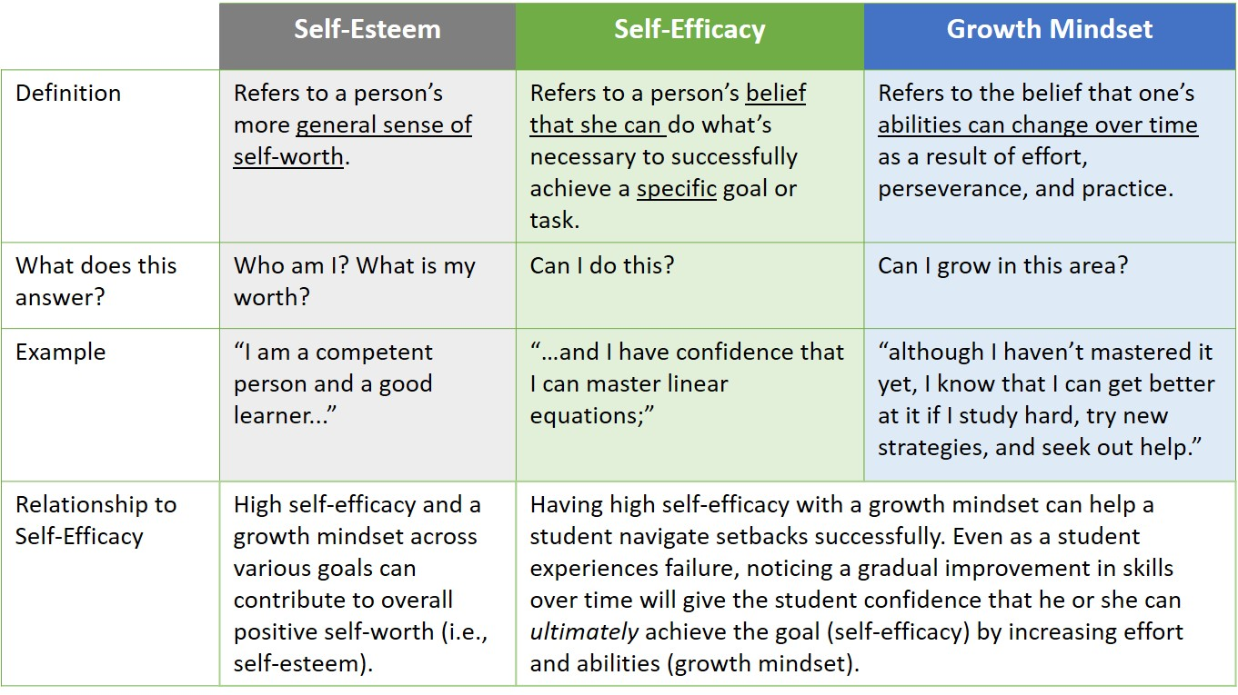
Self-Esteem, Self-Efficacy and Growth Mindset

Slide 45
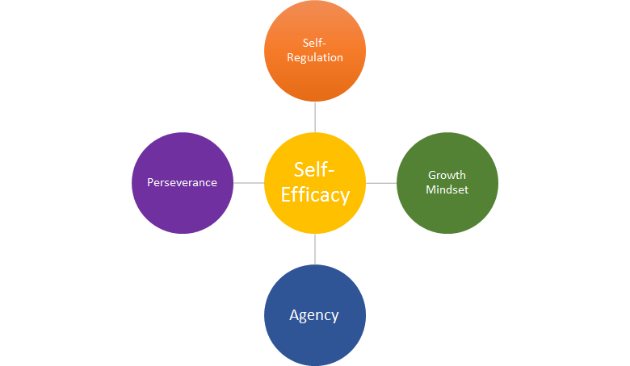
Self-Efficacy as a Gateway to SEL Skills and Habits
Encourages student use of
self-regulatory practices.
Encourages students to persist and not give up in the face of difficulties.
Can help students recover from challenges more successfully by motivating them to increase their efforts and abilities.
Compels students to enact their agency in pursuit of a goal.

Slide 46
Closing the Equity Gap Through Self-Efficacy
Supportive Learning Environments
Provide supports and assistance inside classrooms and school-wide that foster self-regulation and self-management leading to mastery experiences.
Connectedness
Provide students access to role models who look like them and/or have similar upbringings to promote vicarious experiences.

Slide 47
Closing the Equity Gap Through Self-Efficacy
Discipline
Employ school-wide behavioral approaches such as Positive Behavior Interventions and Supports (PBIS) that persuade and encourage positive behavior.
Safety
Provide positive emotional experiences through student clubs or programs designed for African-American students and/or multiculturalism.

Slide 48
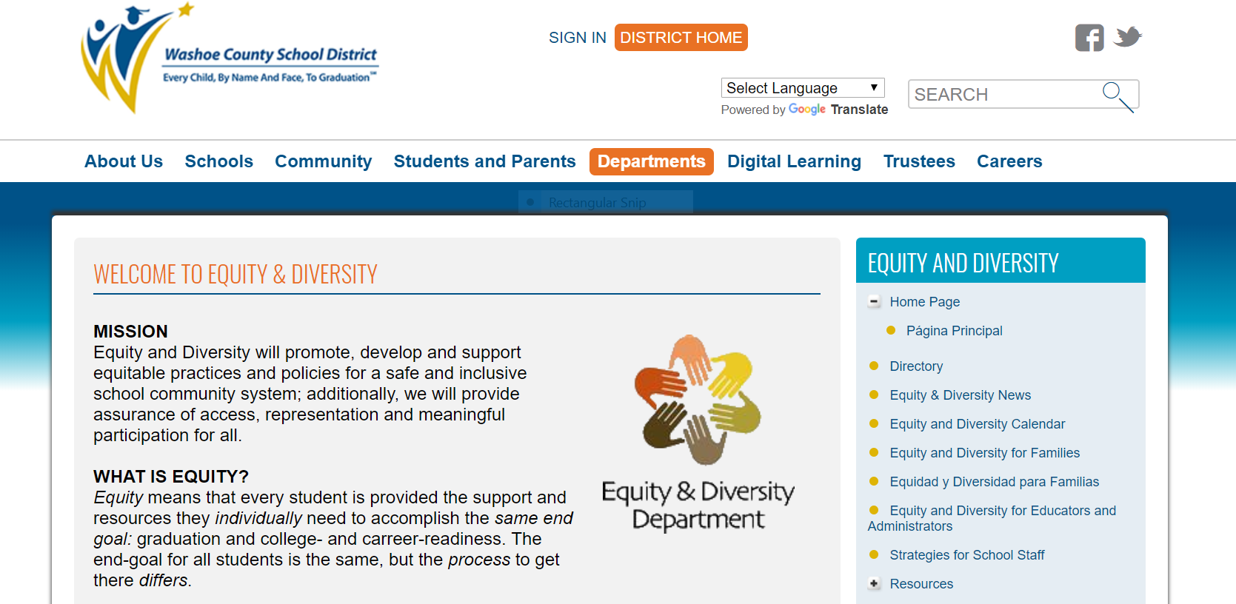
Washoe County School District

Slide 49
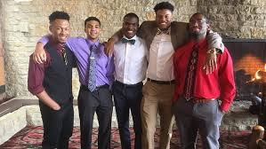
AVID - African American Male Initiative (AAMI)
Video Link

Slide 50
References
Bandura, A. (1993). Perceived self-efficacy in cognitive development and functioning. Educational psychologist, 28(2), 117-148.
Black Minds Matter: Supporting the Educational Success of Black Children in California, The Education Trust-West, 2015.
Bonilla-Silva, E. (2015). The structure of racism in color-blind, “post-racial” America.
Fensterwald, J., Small Rise in California’s Math and Reading Scores in 2018, CA: EdSource, October 2, 2018.
Get Out: Black Male Suspensions in California Public Schools, San Diego, CA: Community College Equity Assessment Lab and the UCLA Black Male Institute, 2018.
Hough, H., Kalogrides, D., & Loeb, S. (2017). Using Surveys of Students' Social-Emotional Learning and School Climate for Accountability and Continuous Improvement. Policy Analysis for California Education, PACE.
Lindsay, R., Robins, K., and Terrell, R., Cultural Proficiency, A Manual for School Leaders, Third Edition, Corwin Press, 2009.

Slide 51
References
Losen, J., and Martin K., The Unequal Impact of Suspension on the Opportunity to Learn in California: What the 2016-17 Rates Tell us About Progress, The Center for Civil Rights Remedies at the UCLA Civil Rights Project, 2018.
Marsh, J. A., McKibben, S., Hough, H. J., Hall, M., Allbright, T., Matewos, A., & Siqueira, C. (2018). Enacting social-emotional learning: Practices and supports employed in CORE districts and schools.
Steele, C. M., & Aronson, J. (1995). Stereotype threat and the intellectual test performance of African Americans. Journal of personality and social psychology, 69(5), 797.
Sue, D. W., Lin, A. I., Torino, G. C., Capodilupo, C. M., & Rivera, D. P. (2009). Racial microaggressions and difficult dialogues on race in the classroom. Cultural Diversity and Ethnic Minority Psychology, 15(2), 183.
Voight, Adam., The Racial School-Climate Gap, WestEd and Human Development Program, 2013.
West, M. R., Buckley, K., Krachman, S. B., & Bookman, N. (2018). Development and implementation of student social-emotional surveys in the CORE Districts. Journal of Applied Developmental Psychology, 55, 119-129.

