Slide 1
Beyond the Obvious
Unmasking Inequality, Diversity ,the Underserved:
Harnessing New Approaches
Viola W Lindsey, MSW ASW PhD
October, 2019
San Diego, California

Slide 2
Historical Trauma
Traumatic event- the Experience- the Effect
events as those in which an individual experiences, witnesses, or is confronted with actual or threatened death or serious injury, or threatened physical integrity of self or other
feeling that world/environment is not a safe place
causes the brain to interact in ways that contribute to survival
Fight, flight, freeze response
Hypervigilance
Difficulty with self-regulation

Slide 3
Historical Trauma
Institutional racism/inequality
Disparity in treatment of certain groups by social and political systems such as criminal justice, education, employment, housing, health care, etc
Diversity
race, ethnicity, national origin, color, sex, sexual orientation, gender identity or expression, age, marital status, political belief, religion, immigration status, or mental or physical ability.
Implicit Bias
unconscious attribution of a particular quality or qualities to a member of a certain group or population
Example: Expressed in wording
Explicit Bias
attitudes and beliefs about a person or group on a conscious level.
Example: Openly expressed

Slide 4
Current/Historical trauma
School shootings
Bullying
Witnessing community violence
Domestic violence
Kidnapping
Severe Natural disasters, hurricanes, tornadoes
Plane crashes
Death of a loved on
Terrorism, police shootings
Physical sexual, emotional abuse
Catastrophic illnesses

Slide 5
Childhood Trauma and Classroom Behavior
https://youtu.be/dw1R_tlWE04
Fight response manifested in
aggression
defiance
reactivity
Impulsivity
Unfortunately, use of punitive treatment , coercive practice, and oppressive language in response to these behaviors, result in children being retraumatized
Flight response manifested in
Withdrawal
Invisibility

Slide 6
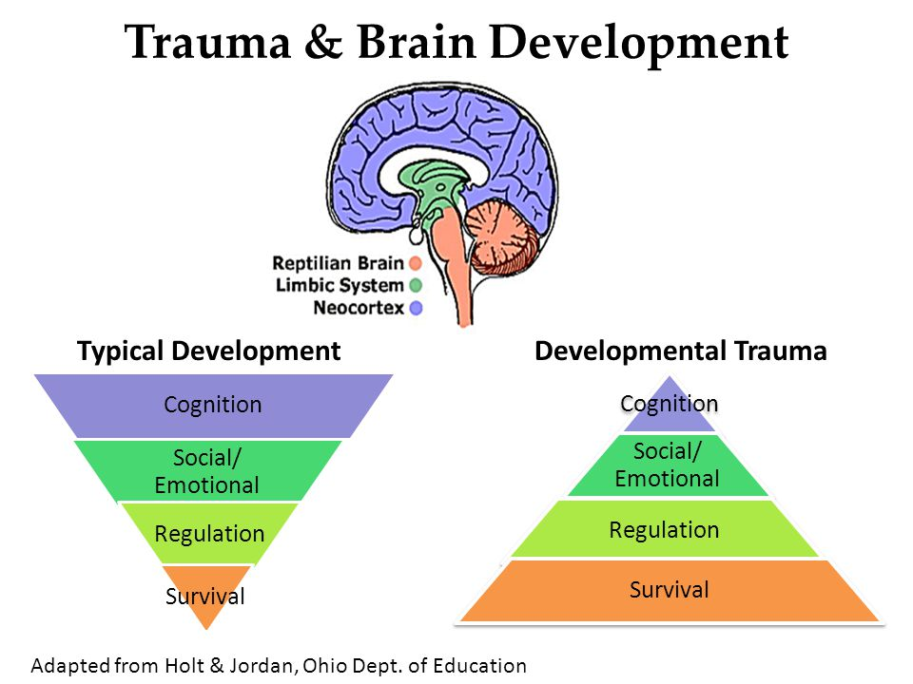
Trauma and Learning

Slide 7
Childhood Trauma and schools
https://youtu.be/z8vZxDa2KPM

Slide 8
Harnessing New Approaches
Trauma Informed Practice
creating a school environment where every student feels safe and supported and where staff understand how trauma affects behavior and emotions.
Recognizing individuals respond to trauma differently
Promote Resilience
Empathic Confrontation
Strength and resilience
Integrity
Dignity and Worth of Person
Feeling respected
Importance of Human Relationships
Stable and caring adult

Slide 9
trauma informed approaches: Core principles From: SAMHSA’s Concept of Trauma and Guidance for a Trauma-Informed Approach (2014)
Safety
Personal interactions as well as physical environment are safe
Trustworthiness and Transparency
Poor sense of self and others
Peer Support
Collaboration and Mutuality
Relationships are key
Empowerment, Voice, and Choice
The Ability to Heal and Recover From Trauma
Cultural, Historical, and Gender Issues
Move past stereotypes and biases

Slide 10
Harnessing New Approaches
The Importance of Relationships
https://youtu.be/to8MhwP8zZQ

Slide 11
Life span impact of Trauma
Adverse Childhood Experiences (Dr. Nadine Burke Harris)

Slide 12
Adverse Childhood Experience (ACE) Questionnaire
The higher the score , the higher the level of risk

Slide 13
Harnessing New Approaches
Trauma, Brain and Relationship: Helping Children Heal DR Bruce Perry
https://youtu.be/RYj7YYHmbQs

Slide 14
Trauma informed Approaches what does it mean?
A different mind-set from instead of asking what’s wrong with you, instead ask what happened to you
A primary goal is to prevent re-injury or re-traumatization by acknowledging trauma and its triggers, and avoiding stigmatizing and punishing students.
By recognizing children who have been exposed to trauma ,and creating an environment that allows them to feel safe, many behavioral problems and disciplinary measures such as detentions, suspensions, and expulsions can be avoided.

Slide 15
Harnessing New Approaches School as a safe haven- Oprah Winfrey
https://youtu.be/dF20FaQzYUI

