Slide 1
One Family at a Time
Parent Education & Consultation Program
Notes:
Rami

Slide 2
“Parent engagement is about relationships, not money”
Let us examine the premise
Notes:
Rami

Slide 3
ABOUT US
Los Angeles County Office of Education
Largest COE in the nation
8,000+ students enter our doors
Largest Juvenile Court School
4,751 square miles
WASC Accredited
Notes:
Felipe

Slide 4
Juvenile Court Schools
“family involvement as one of three most important issues [facing education for adjudicated minors], but also the most operationally challenging [one].”
(Center for Juvenile Justice Reform, 2008)
Notes:
Felipe

Slide 5
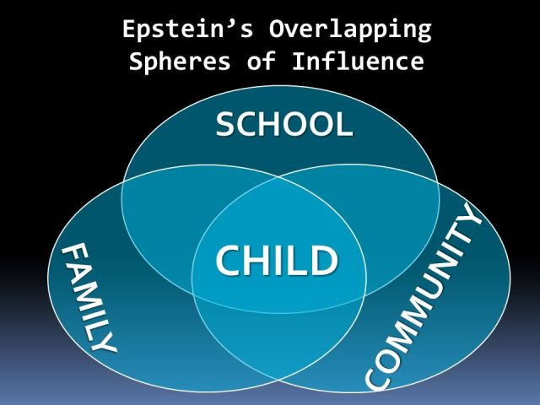
Strengthening the Family
The Curriculum
Socio-emotional needs
Prevention and Support
College and Career Readiness
Community
Notes:
Jael

Slide 6
The Curriculum – Meet the Needs
Motivational Speakers
Experts In The Field
Navigating the Juvenile System
Community Resources
Researchers
Violence Prevention
Gang Intervention
Drug and Alcohol Abuse Prevention
Human Trafficking Awareness
College Knowledge for Parents
Resiliency
Improving Communication Within The Family
Fatherhood and Parenting Styles
Bullying Stops With You
The Power of Education
Educational Technology
Notes:
Jael

Slide 7
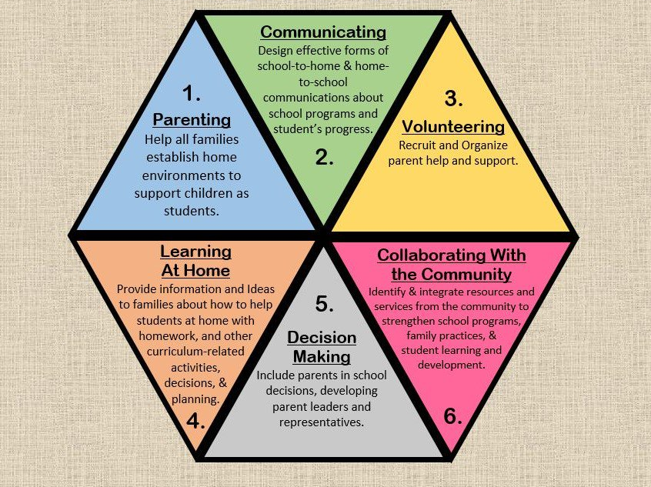
The Curriculum
Notes:
Jael

Slide 8
Principles for Growth
Focus is on the needs of families and communities.
High Quality Instruction
Positive Relationships
Making connections to resources
Research-based
Community Partnerships
Civic and local resources
Safe Culture
Welcoming and caring people
Notes:
Jael

Slide 9
Opportunities for Families
Workshops per Year
Past practice
Notes:
Felipe

Slide 10
Participants
2,000+
2,000+
1,600+
2017-18
2018-19
2016-17
471
2015-16
Notes:
Felipe

Slide 11
Growth Strategy
4
3
Steps to support, guide and solicit feedback from families
2
2018-19
2017-18
Year 3 Maintenance and Expansion
1
Year 2 Implementation
2016-17
Personalized Outreach
Led by Staff
All PAUs
2nd Annual Parent Conference
PAC/DELAC
Community Partnerships
Court-mandated Parenting Classes
LACOE Curricula
Personalized Outreach
Led by Staff
All PAUs
3rd Annual Parent Conference
PAC/DELAC
Community Partnerships
Court-mandated Parenting Classes
LACOE Curricula
Support to Community Schools Initiative
Year 1 Implementation
2015-16
Personalized outreach
Led by Staff
All PAUs
1st Annual Parent Conference
PAC/DELAC
Community Partnerships
Court-mandated Parenting Classes
Past Practice
Vendor Contracted
5 School Sites
Notes:
Jael

Slide 12
Title I – Supporting Family Engagement
Vendor Driven
Served 5 schools
Limited and restricted
2015-16
$450,000
Subsequent Years
LACOE Driven
All Schools
Autonomous
Capacity Building
Staff Driven and Supported
Superintendent’s Support
$125,000
Notes:
Rami

Slide 13
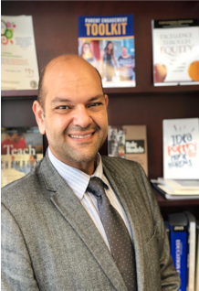
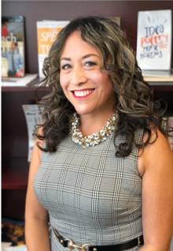
OUR TEAM
Supporting families and students one at a time.
Jael
Ovalle
Rami Christophi
Project Director, Title I
Program Manager, Parent Education
(562) 401-5739 (Office)
(562) 774 5624 (Cell)
(562) 401 5534 (Office)
(213) 434 2939 (Cell)
Notes:
Jael, Rami, Felipe

Slide 14
THANK YOU!
LACOE
Phone:
562-401-5534
Email:
Ovalle_jael@lacoe.edu
Website:
http://www.lacoe.edu/

